Slide 1

Document version: CURRENT
Document Owner: Paul Armstrong <parmstro@redhat.com>
Document Confidentiality: Public
Current Recommended Version: This document
Content Owner: The user responsible for each slide’s content is marked in the speaker notes
See: Contributors page
This document follows the ABCD Versioning Notation Lifecycle

Slide 2
Contributing:
This is the MAIN DECK: we are trying to ensure that the other decks link into this deck for their content.
If you have an idea we want to see it!
Please add slides that you would like to see into this deck. If they need a section, add the section separator slide. Tag your slide in the content notes section with:
[Content Owner]: <Your Name>
This helps in collaborating with others. There are lots of editors :-)
You are responsible for maintaining your content in this deck. Please only edit your own content.
If you need to make changes for a customer presentation, please make a copy to your own drive.
Notes:
[Content Owner]: Paul Armstrong

Slide 3
Using this Deck:
This Deck is not intended to be presented to customers as is. It functions more as a library of slides. There are many pre-assembled decks in this folder that are targeted at particular audience. Please take a look at them. You are encouraged to make a copy to your own drive so that you can modify presenter info and add slides from this deck or from other topics to meet your needs.
If you link the slides in this deck to your presentation, you will see the updates when we make changes. Saves some work on your part, and keeps our message consistent.
the RH-ISAM Team
Notes:
[Content Owner]: Paul Armstrong

Slide 4
The Red Hat Infrastructure Standard Adoption Model
[v1.2 Current]
Main Deck
Presenter1
Presenter1_Title
Presenter2
Presenter2_Title
Notes:
[Content Owner]: Paul Armstrong

Slide 5
Red Hat Infrastructure Standard Adoption Model
A Framework of managing Red Hat Enterprise Linux infrastructure at Scale
Presenters:
[Presenter1]
[Presenter2]
Notes:
[Content Owner]: Martijn Ten Heuvel, Paul Armstrong

Slide 6
Why are we doing this?
Red Hat Infrastructure Standard Adoption Model
Notes:
[Content Owner]: Paul Armstrong

Slide 7

Red Hat Infrastructure Standard Adoption Model
Red Hat Infrastructure Standard Adoption Model
WHAT ARE WE TRYING TO ACHIEVE?
Aging and end-of-life operating system platforms present serious operational and security challenges to our customers. This approach assists customers in their need to modernise their platforms without disrupting critical business while adopting recommended practices and workflows.
WHAT IS THE RED HAT INFRASTRUCTURE STANDARD?
This workload centric approach is to assist customers with the following:
Run workloads on Red Hat Enterprise Linux at scale in a hybrid multi-cloud environment.
Adopting Red Hat recommended practices and workflows.
Streamline Operations by standardising on workloads on Red Hat Enterprise Linux.
Allow for modernization of workloads by converting workloads to RHEL and upgrading in-place.
Reduce Technical Debt, Operationalise Security and Compliance, Automate delivery and maintenance.
Notes:
[Content Owner]: Martijn Ten Heuvel, Paul Armstrong

Slide 8
Framing the State of our Systems
Red Hat Infrastructure Standard Adoption Model
Software END OF LIFE EVENTS will always occur, generating technical debt
SO… How do we solve the problem of TECHNICAL DEBT?
Technical debt is not a PROBLEM to solve, it is a STATE to manage…
SO … Make the software lifecycle easier to MANAGE. Is it that easy?
Systems have generally been hard to change and manage due to their BESPOKE nature and the MANUAL PROCESSES necessary to build and maintain them.
FINALLY, today it is possible to AUTOMATE complex builds and processes. However, to make this COST EFFECTIVE and SCALE we must FIRST STANDARDIZE.
Automating snowflakes simply creates more expensive snowflakes faster.
Notes:
[Content Owner]: Paul Armstrong

Slide 9
Why do Customers need this?
Red Hat Infrastructure Standard Adoption Model
Organisational reasons to implement RH ISAM
Strategic
We only run supported software
Everything runs in the cloud/We moved to the cloud
We have adopted modern application development methods
We use secure platforms
We need to ensure software on our platforms comes from trusted sources
We use Automation as standard to ensure consistency, efficiency, and scalability of our teams
Tactical
All systems should have a vendor supporting them
Applications need to be adapted to cloud deployment
Our monolithic applications need to be modernized
We need to update our hardware / software frequently to stay secure
Our systems and software must comply with our security and compliance standards
We need to free up administration time to focus on modernizing infrastructure
Operational
My systems ran out of support / I need to prolong the support lifecycle
I need to migrate to a vendor supported solution
The OS for critical application ‘X’ is out of support and needs to be upgraded
My hardware is end of life
I need to manage software lifecycle
I need to modernize a monolithic application
I want to do less firefighting and create value
Notes:
[Content Owner: Martijn Ten Heuvel, Jelke Dijkstra, Paul Armstrong]
Strategic goals, tactical implementation or operational situations all lead to the need for infrastructure modernisation. Each level has upsides of having an automated, supported and scalable IT infrastructure landscape. It aligns with the need for application modernization, cloud migrations, security, but also with the needs of the engineer who has to much to do on a day-to-day base. Every organization needs to do more with less people, automating (Linux) infrastructure saves time that can be invested into modernization of the application landscape.
https://www.ibm.com/topics/digital-operational-resilience-act "exit strategy" site:www.digital-operational-resilience-act.com Digital Operational Resilience Act (DORA)
Article 28, General principles
8. For ICT services supporting critical or important functions, financial entities shall put in place exit strategies. The exit strategies shall take into account risks that may emerge at the level of ICT third-party service providers, in particular a possible failure on their part, a deterioration of the quality of the ICT services provided, any business disruption due to inappropriate or failed provision of ICT services or any material risk arising in relation to the appropriate and continuous deployment of the respective ICT service, or the termination of contractual arrangements with ICT third-party service providers under any of the circumstances listed in paragraph 7.
Financial entities shall ensure that they are able to exit contractual arrangements without:
(a) disruption to their business activities,
(b) limiting compliance with regulatory requirements,
(c) detriment to the continuity and quality of services provided to clients.
Exit plans shall be comprehensive, documented and, in accordance with the criteria set out in Article 4(2), shall be sufficiently tested and reviewed periodically.
Financial entities shall identify alternative solutions and develop transition plans enabling them to remove the contracted ICT services and the relevant data from the ICT third-party service provider and to securely and integrally transfer them to alternative providers or reincorporate them in-house.
Financial entities shall have appropriate contingency measures in place to maintain business continuity in the event of the circumstances referred to in the first subparagraph.

Slide 10
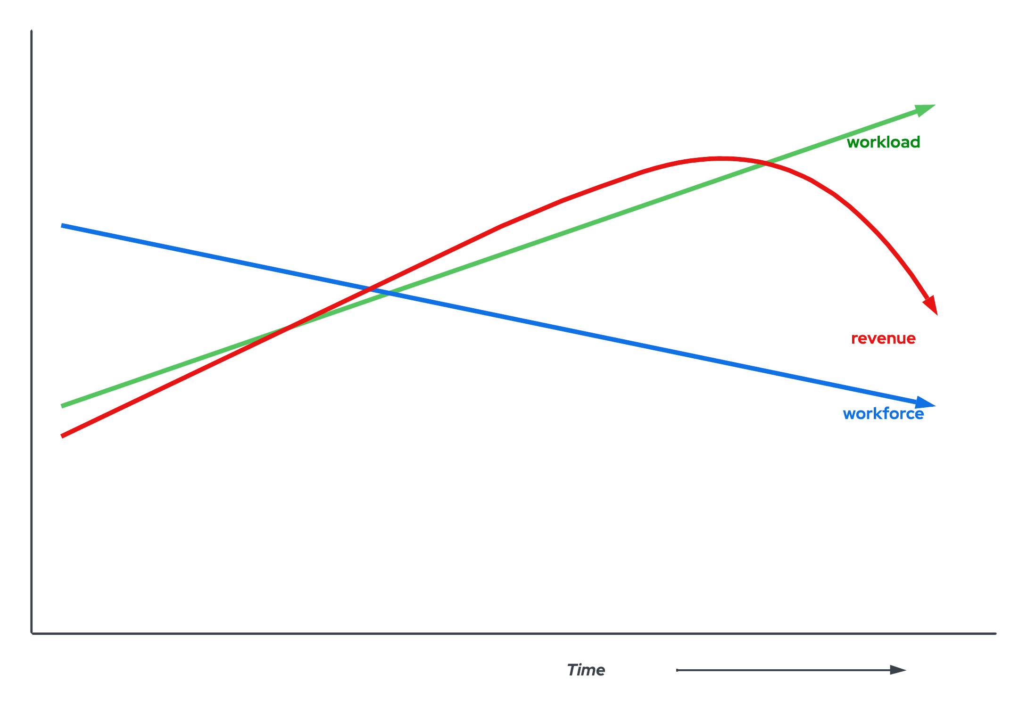
General challenges
Red Hat Infrastructure Standard Adoption Model
Workloads continues to grow
Workforce continues to decline
Responsibilities become unclear
Demand for accountability and auditability grows
Quality becomes an issue
As a consequence, customers start to leave, revenue declines
Support is no longer a given
Staff and application workloads are buckling under the burden of technical debt. The migration to cloud is taking too long. There are skill and infrastructure gaps that are preventing container native adoption.
Notes:
[Content Owner: Martijn Ten Heuvel, Paul Armstrong]
This covers more reasons why to convert/upgrade/migrate
What we see at customers is that their workloads always grow.
However, we also see customers having their workforce decline, for various reasons.
Oftentimes, this means the corresponding responsibilities become unclear, things like raci tables may exist but aren’t known, enforced or maintained.
Demands for accountability and auditability grow: it is needed to prove the state of systems. Audits lead to disaster, as the entire organization is stuck when the
Quality becomes an issue and as a consequence, customers start to leave and revenue declines.

Slide 11
Challenges of managing technical debt
Red Hat Infrastructure Standard Adoption Model
Operating Systems from 2007 and earlier
Managed system software is reaching / has reached end of life:
New hardware is not supported
Application requirements surpass what it can offer
Customer needs to be in support for XX years to come
The application provider demands new versions to be able to provide support
Modernisation to containers is not ready, support still required
Application have been installed without complying to standard over the years
Snowflakes rule the data centre
Notes:
[Content Owner: Martijn Ten Heuvel, Paul Armstrong]
This slide identifies the sources of the strategy described in the previous slide.
This covers reasons why to convert/upgrade/migrate

Slide 12
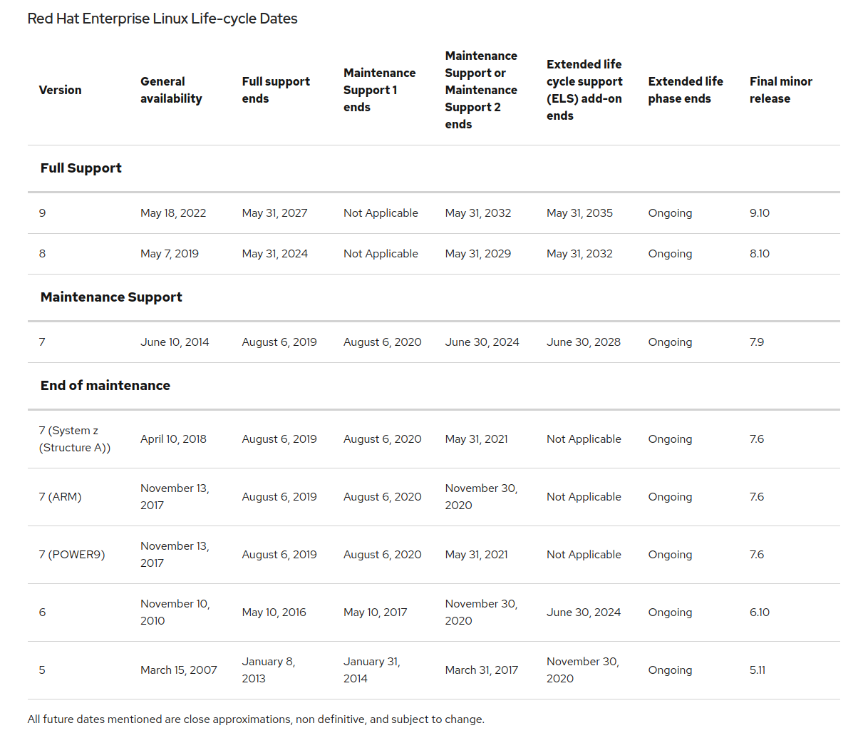
Red Hat Enterprise Linux Life-cycle dates
Red Hat Infrastructure Standard Adoption Model
Range: Earliest GA to Latest ELS end date
2010 to 2035
= 25 years
Customers and Red Hat want to shrink this gap
Notes:
[Content Owner: Martijn Ten Heuvel]
Life-cycle dates as presented at https://access.redhat.com/support/policy/updates/errata/
This overview provides insights into the timelines Red Hat provides for the adoption of new versions of the platform.
CentOS 7 END date is June 30th 2024. This aligns to the end date of RHEL7 Maintenance Support 2 ending. (https://www.centos.org/centos-linux/)
Important: there are releases such as the Update Services for SAP Solutions which may follow a different path

Slide 13








Who is invested in ensuring success?
Red Hat Infrastructure Standard Adoption Model
“”
“”
“”
“”
We need to manage, maintain and automate my Linux platforms to improve my quality of services.
We have to be able to manage more systems and comply to complex standards. We need to standardize and automate to do so.
We cannot risk to be exposed to security risks. Systems that are not supported are a big risk.
We have requirements to at any time have a up-to-date, fully and commercially supported estate.
Linux Admin
Linux Admin Manager
Chief Information Security Officer
Chief Information Officer
Notes:
[Content Owner]: Martijn Ten Heuvel, Jelke Dijkstra
The personas are here to identify where we are going to be able to position the solution

Slide 14

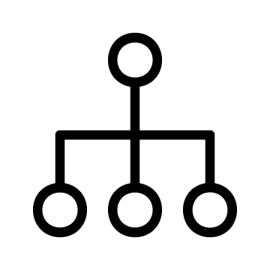









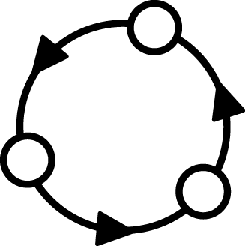
Adopt Red Hat Infrastructure the right way!
Red Hat Infrastructure Standard Adoption Model
Standardise intelligently and automate to enable responsive IT
Fragmented ‘approach’ |  | Snowflakes Tool-du-jour Manual, error-prone | Documentation gaps Tribal knowledge Silos of expertise | Legacy deployments Technical debt Static images
Standard Operating Environment
Standardize
Automate
Iterate
Notes:
[Content Owner]: Paul Armstrong
Linux Adoption is no different than any other operating system. It starts with 1 guy deploying 1 server and figuring out how it is supposed to work. Then they create a second system and connect them on a network. Now they have to figure out all the things that make systems talk and play nice with each other on a network.
Authentication, Name Services, Time Services, etc.. all the things that are there before we even think about putting an application on a system.
Then we have to keep it up to date as we work with it, back it up, configure it.
All this is pretty simple with 2 machines and not very labour intensive.
What happens when we get to 10? 100? 1000?
Each team can take their own approach to these challenges. Then when they come together, we get standards that, well, aren’t so standard.
Why can’t I create an infrastructure like a cloud provider!... Well you can. There are some steps we need to take though.
Cloud providers scale, because of automation. They can only automate because they are highly standardized. *This* is the way we do “X”
So, we need standardization before we can automate.
Its not done, because its never perfect. Perfect is the enemy of Good.
So we Iterate. What does this start to look like… What are some of our blockers..

Slide 15

Standard Infrastructure Deployment
Red Hat Infrastructure Standard Adoption Model
What, how, and why
 | Challenge |  | Approach |  | Benefits
Fragility
Systems are specified and built with inflexible scripts and/or complex procedures that make reuse and revision difficult
Refactor
Redefine systems in functional layers and reusable elements for a component-based approach to Standard Operating Environment
Flexibility
Update components independently and recombine easily to streamline SOE definition and maintenance
Variability
New patches, updates, and configurations are applied piecemeal across the environment multiplying inconsistencies
Standardize
Codify content delivery, configuration, and lifecycle management with tooling and monitoring
Efficiency
Easily monitor and manage drift, versioning, and compliance with system-wide or individual remediation
Complexity
Manual processes and complex scripts lead to errors in production that are hard to isolate and resolve.
Automate
Specify system build and configuration in human readable language and validate delivery in lab environments.
Reliability
Rapid and repeatable provisioning of proven production systems, in isolation or en mass, with trusted automation
Notes:
[Content Owner]: Paul Armstrong
One of the concepts that we will discuss in that of the Standard Operating Environment. In a nutshell, it encompasses the content that we allow on our Linux systems, but it also helps us define how and when it gets there. One of the challenges that we at Red Hat see in many customers is that the way in which systems are spec’d out and built is so customized, that it is essentially a monolith. Once it is built, maintenance, revision and reuse are next to impossible. Also, different parts of the organization may have implemented different standards, or generated exceptions to meet deadlines, etc.. If we take the time to redefine the systems in terms of the functional layers of the software stack we can drive out the necessary components The refactoring will revive the flexibility in our environment, allowing more easy recombination and streamlining maintenance.
As we refactor the components of the Operating Environment, we can drive standardization by codifying content delivery, configuration, lifecycle and compliance through tooling. The standards drive efficiencies
We need to show both the process and the architecture… the process is our consulting methodology and agile process and our architectures are tested in the field with some of our largest and most valued customers.
People -> Innovation Lab will train them…

Slide 16
Customer Journey
Adopt the Red Hat Infrastructure Standard
As the Chief Information Officer responsible for running the IT organization I need to improve quality and supportability so that I can reduce business risks, exposures, and down-time
Customer Success User Story
Customer Success Journey Map
Pilot
Train the team
+ GLS courses
+ Mentor the mentor
Infrastructure Discovery
Navigate to RH-ISAM
Design & Deploy Red Hat Platform components
Create required automation steps
+ ansible
Scale
+ factory
+ ramp up
Analyse environment
Products used in the Journey Map
Red Hat Satellite
Ansible Automation Platform
Red Hat Identity Management
Red Hat Cloud Services
Professional and Learning Services, Technical Account Management
Notes:
[Content Owner]: Martijn Ten Heuvel, Jelke Dijkstra

Slide 17
RH Services: Red Hat Infrastructure Standard
Red Hat Infrastructure Standard Adoption Model
A modular framework to support customer infrastructure modernisation - click on components for more information
Migrate to RHEL
Analysing workloads on non-RHEL platforms (inc. legacy UNIX, Windows, Linux), creating a migration strategy, replatforming candidate workloads on RHEL using a migration factory approach.
Convert to RHEL
Analysing and converting in-place rpm based operating systems to RHEL.
This allows in-place upgrade to eliminate technical debt.
Upgrade to RHEL8 or 9
Analysis and in-place upgrading servers running older versions of RHEL to RHEL8 or RHEL9.
Modernize Virtualization
Deploy New Virtualization Platforms and migrate workloads onto it.
Modernize Application Delivery
Analysis and migration of applications running any operating system to a standard methodology
Deliver All Standard Workloads through Automation
Plugable Solutions
at least one + Contribute
Implement the Red Hat Infrastructure Standard Platform
Required :building a secure, stable, manageable, automated RHEL platform to scale workloads on
Foundational
Navigate to the Red Hat Infrastructure Standard
Engage with Red Hat to fully determine requirements, operational readiness.
* This component is mandatory unless the customer already has a RHEL Standard Operating Environment in place.
Notes:
[Content Owner]: Martijn Ten Heuvel, Paul Armstrong
The pillars (Migrate/Convert/Upgrade.. ) provide options. These options all lead to the same end result - which is a Red Hat supported (RHEL) platform.
There may be steps to choose from, steps to skip and steps that cannot be skipped.

Slide 18
Red Hat Infrastructure Standard Service Capabilities
Red Hat Infrastructure Standard Adoption Model
A modular framework to support customer infrastructure modernisation - click on components for more information
Migrate to RHEL
Analysing workloads on non-RHEL platforms (inc. legacy UNIX, Windows, Linux), creating a migration strategy, replatforming candidate workloads on RHEL using a migration factory approach.
Convert to RHEL
Analysing and converting in-place rpm based operating systems to RHEL.
This allows in-place upgrade to eliminate technical debt.
Upgrade to RHEL8 or 9
Analysis and in-place upgrading servers running older versions of RHEL to RHEL8 or RHEL9.
Modernize Virtualization
Deploy New Virtualization Platforms and migrate workloads onto it.
Modernize Application Delivery
Analysis and migration of applications running any operating system to a standard methodology
Deliver All Standard Workloads through Automation
Plugable Solutions
at least one + Contribute
IT STARTS HERE
Implement the Red Hat Infrastructure Standard Platform
Required :building a secure, stable, manageable, automated RHEL platform to scale workloads on
Foundational
Navigate to the Red Hat Infrastructure Standard
Engage with Red Hat to fully determine requirements, operational readiness.
* This component is mandatory unless the customer already has a RHEL Standard Operating Environment in place.
Notes:
[Content Owner]: Martijn Ten Heuvel, Paul Armstrong
The pillars (Migrate/Convert/Upgrade.. ) provide options. These options all lead to the same end result - which is a Red Hat supported (RHEL) platform.
There may be steps to choose from, steps to skip and steps that cannot be skipped.

Slide 19
Red Hat Infrastructure Standard Service Capabilities
This is the upgrade factory
Red Hat Infrastructure Standard Adoption Model
A modular framework to support customer infrastructure modernisation - click on components for more information
Migrate to RHEL
Analysing workloads on non-RHEL platforms (inc. legacy UNIX, Windows, Linux), creating a migration strategy, replatforming candidate workloads on RHEL using a migration factory approach.
Convert to RHEL
Analysing and converting in-place rpm based operating systems to RHEL.
This allows in-place upgrade to eliminate technical debt.
Upgrade to RHEL8 or 9
Analysis and in-place upgrading servers running older versions of RHEL to RHEL8 or RHEL9.
Modernize Virtualization
Deploy New Virtualization Platforms and migrate workloads onto it.
Modernize Application Delivery
Analysis and migration of applications running any operating system to a standard methodology
Deliver All Standard Workloads through Automation
Plugable Solutions
at least one + Contribute
IT STARTS HERE
Implement the Red Hat Infrastructure Standard Platform
Required :building a secure, stable, manageable, automated RHEL platform to scale workloads on
Foundational
Navigate to the Red Hat Infrastructure Standard
Engage with Red Hat to fully determine requirements, operational readiness.
* This component is mandatory unless the customer already has a RHEL Standard Operating Environment in place.
Notes:
[Content Owner]: Martijn Ten Heuvel, Paul Armstrong
The pillars (Migrate/Convert/Upgrade.. ) provide options. These options all lead to the same end result - which is a Red Hat supported (RHEL) platform.
There may be steps to choose from, steps to skip and steps that cannot be skipped.

Slide 20
Where you want to be
Pilot
Discovery
Create and build modernisation paths
Deploy automation tools
Design and deploy SOE
Test modernisation of workloads Use side by side comparisons, use dark launches, test deployments
Define the factory
Define day 2 operations and other standards
Why is this important?
Who will be responsible?
Who will be involved in execution?
What is the task we need to execute?
What are target applications?
Navigate
Scale
Review the current environment and integrations, dependencies
Review applications and review systems running these applications, identify and commit to the order of migrations
Analyse where these applications can go to: RHEL, containers, bin, and so on.
High level design for the new RHEL environment, including security model based on HBAC and RBAC and central directory services
Common understanding of the task at hand
Deploy the modernisation factory
Plan for modernisation
Modernize remaining systems
Implement responsibilities
Where you are
Notes:
[Content Owner]: Martijn Ten Heuvel
We try to use the golden circle (Why > How > What) methodology here; we first want to understand the why before we can continue. This is covered in the Discovery.
The journey described here starts with a Discovery. Discovery is our Triage, the way we find out what would be the thing we need to address.
Discovery is followed by Navigate. Navigate is our deepdive into the thing found in Discovery. In this case, we Navigate to RH-ISAM. In the analogy, navigate is the way we determine what we should be doing, the plan we create.
The Pilot is there to build towards the solution. What the solution exactly entails is variable (see slide Slide 6) and will be up to the customer and what came out of Navigate. We at least expect the underlying infrastructure components (Satellite, IDM, AAP, Cloud services) and the day 2 operations as mentioned. At the end of Pilot the first components in productions have been targetted. Red Hat Leads this section,
Finally, during Scale, the automation is used to migrate/upgrade/convert/… the rest of the estate. The customer leads this section.

Slide 21








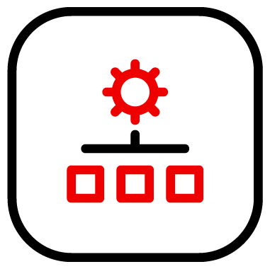



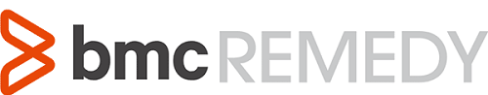

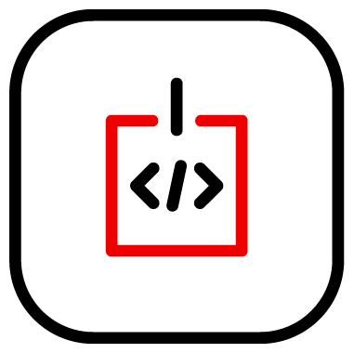






RH-ISAM in a Hybrid Cloud Deployment
Red Hat Infrastructure Standard Adoption Model
Red Hat Infrastructure Standard
Common Code and Process Across All Environments
Red Hat Hybrid Cloud
Services
Security/SSO
Lifecycle
Automation
Compliance
Configuration
Native AD Trust
Data Center 1
Data Center 2
Cloud 1
Region 1
Cloud 1
Region 2
Cloud 2
Cloud 3
Notes:
[Content Owner]: Paul Armstrong, Mike Savage
Abstracting Differences in the various data centers and cloud delivers Consistent Process and Reduces the impact of Change.
Automation can define processes to deliver content; define and deploy systems; check compliance and manage configuration; all by simply changing the variable values and not the underlying code.
As an example, using image builder we can define a cloud image from RHEL8 built from a Satellite content view. We can deploy that to AWS, Azure, VMware or OpenStack based simply on specifying the target connection information. We can then have Satellite deploy the image, again, by simply specifying the Compute Resource. Ansible can manage the host configuration no matter where it resides. When the image is deployed and configured for IdM integration, all the centralized policy is implemented on the system, again simply and easily.

Slide 22
Customer Needs
Red Hat Infrastructure Standard Adoption Model
Organisational reasons to implement RH ISAM
Strategic
We only run supported software
Everything runs in the cloud/We moved to the cloud
We adopted modern application development methods
We use secure platforms
Software on our platforms comes from trusted sources
We use Automation as standard for consistency and saving time
Tactical
All systems should have a vendor supporting them
Applications need to be adapted to cloud deployment
Our monolithic applications need to be modernized
We need to update our hardware / software frequently to stay secure
Our systems and software must comply with our security standards
Using automation to save time for modernization jobs
Operational
My systems ran out of support / need to prolong support lifecycle
I need to migrate to a vendor supported solution
The OS for critical application ‘X’ is out of support and needs to be upgraded
My hardware is end of life
I need to manage software lifecycle
I need to modernize a monolithic application
I want to do less firefighting and create value
Notes:
[Content Owner: Martijn Ten Heuvel, Jelke Dijkstra]
Strategic goals, tactical implementation or operational situations all lead to the need for infrastructure modernisation. Each level has upsides of having an automated, supported and scalable IT infrastructure landscape. It aligns with the need for application modernization, cloud migrations, security, but also with the needs of the engineer who has to much to do on a day-to-day base. Every organization needs to do more with less people, automating (Linux) infrastructure saves time that can be invested into modernization of the application landscape.
https://www.ibm.com/topics/digital-operational-resilience-act

Slide 23
Where does the RH-ISAM fit in the Strategy?
Notes:
[Content Owner]: Paul Armstrong

Slide 24
Capability Matrix for Flight Path
Red Hat Infrastructure Standard Adoption Model
Inflection Point
Platform Prep
Platform Delivery
Overall maturity increases up and to the right Copy this slide and use the colour fill key below to generate your map.
CI Framework
RH-ISAM
Observability Pub/Sub
Security Services Provisioning
Platform Workflow
Declarative Infrastructure
Operator Certification
Chargebacks
Automated Governance
Network Provisioning
Runbook Automation
Platform Security
Sidecar Integration
Resiliency Validation
Application Lifecycle Automation
Platform Bill of Materials
Storage Provisioning
Provisioning Mgmt
Prod-like Sandbox
Secrets Management
Build Pipelines
Disaster Recovery / Active Failover
FinOps
Software Bill of Materials
Compute Provisioning
Version Control
Single Containers
Storage/Network integration
Deployment Integration
Fleet Management
Zero Trust
Custom Policy Enforcement
Config Mgmt
Automation Workflow
Dev Workstations
Workload Analysis
Image Ingestion
SRE Patterns
Service Mesh
Reg. Auditing & Reporting
Foundational Automation
Infrastructure Automation
Container Development
Container Platform Essentials
Workload Intake Acceleration
Platform Services
Advanced Capabilities
Regulatory Support
Key:
Under Performing
Rudimentary
Developing
Acceptable
Advanced
Leading
Adapted From: Flight Path End to End by Adam Seeley and Bob Mader
Notes:
[Content Owner]: Paul Armstrong
Adapted from Flight Path End to End by Adam Seeley and Bob Mader
This slide represents the Stages for the Flight Path journey and the capabilities needed within the organization infrastructure in order for that stage to be considered successfully completed. This is not to imply that all of the capabilities in each stage must be a leading level before proceeding to the next stage but rather a measure of overall capability and likelihood of success. The goal of the chart is to allow the leadership team to gauge current overall success of the effort by having stakeholders estimate capability across the teams that make up the effort.
Copy this slide for the initial review of capabilities and set the fill colour of each capability to create a capability map/matrix. At each subsequent review copy the previous reviews map and update it for the current review to generate a timeline of success.

Slide 25
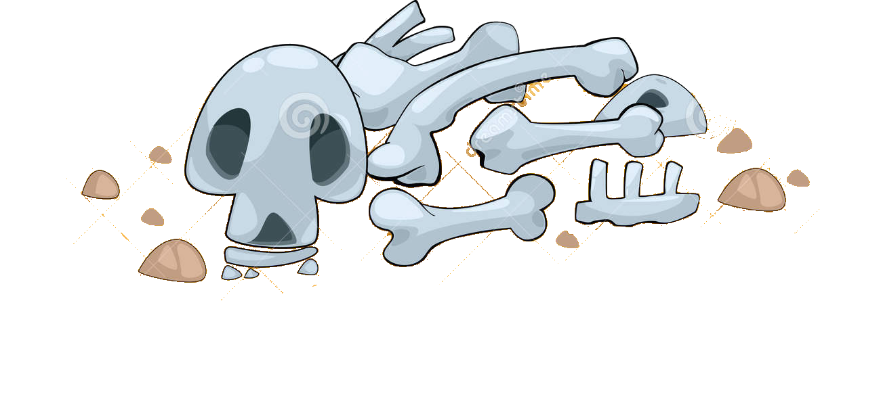
Cloud Native Adoption Curve
Entering at the wrong point in the continuum == failure
Red Hat Infrastructure Standard Adoption Model
RH-ISAM
Network
Automation
Secured Supply Chain
IaC
Builds
Multi-Cloud
Server Provisioning
Zero Trust
GitOps
CI/CD Scaffolding
Return on Investment
In-Place Upgrades
OpenShift
Enterprise Pipelines
Migration Factories
OpenShift + ACM + ACS
Developer
Workstations
Container Dev Environment
FlightPath capability matrix
Entry Automation | Infra automation | Container Development | Container Platform Essentials | Workload Intake Acceleration | Platform Services | Advanced Capabilities | Regulatory Support
RH-ISAM can deliver immediate value and is the precursor to success.
Time
Adapted From: Flight Path End to End by Adam Seeley and Bob Mader
Notes:
[Content Owner]: Paul Armstrong
Adapted from Flight Path End to End by Adam Seeley and Bob Mader
This slide illustrates the expected return on investment an organization will realize as they migrate processes to adopt cloud native technologies. Overlaid on this timeline are the capabilities expected to achieve this as outlined in the flightpath capabilities matrix. What we have learned from working with customers is that:
Without careful consideration of the entire matrix failure is a highly probable outcome. (Failed projects, orphaned clusters, one-of implementations)
In order to be successful, an organization must be fully capable w.r.t. automation across the infrastructure
Upgrading/migrating/replatforming snowflakes, begets snowflakes. It does not eliminate technical debt. Refactoring is a must.
The traditional VM infrastructure must come along for the ride. Without applying gitOps strategies to the traditional infrastructure, it is difficult or impossible to achieve success.
This is where the RH-ISAM fits. Driving gitOps strategies into the traditional infrastructure.
This is centered around the concept of a Standard Operating Environment. This is not a new concept.

Slide 26
Combining OpenShift with the Curve
Build-up of RHEL, Ansible and OpenShift platform capabilities that are used to accelerate application adoption.
Red Hat Infrastructure Standard Adoption Model
RH-ISAM
Network
Automation
Secured Supply Chain
Prod-like Sandbox
IaC
Builds
Security patching
Multi-Cloud
Server Provisioning
Product upgrades
Zero Trust
Dynamic scaling
GitOps
CI/CD Scaffolding
Return on Investment
Ephemeral environment
In-Place Upgrades
Container Dev Environment
OpenShift
Automated deployments
Developer
Workstations
Enterprise grade environment
Configuration Management
Configuration
Non-Production
Lifecycle Management
GitOps
Production Environments
Self Service
Scale
Entry Automation | Infra automation | Container Development | Container Platform Essentials | Workload Intake Acceleration | Platform Services | Advanced Capabilities | Regulatory Support
Time
Adapted From: Flight Path End to End by Adam Seeley and Bob Mader
Notes:
[Content Owner]: Paul Armstrong
Adapted from Flight Path End to End by Adam Seeley and Bob Mader

Slide 27
A Standard Operating Environment
Red Hat Infrastructure Standard Adoption Model
What is it and why do I need one?
Notes:
[Content Owner]: Paul Armstrong

Slide 28
What is a Standard Operating Environment?
Red Hat Infrastructure Standard Adoption Model
The model for the conditions under which we control our machines, systems and processes.
Value is created when we can refactor infrastructure deployments to a short, discrete list of SOEs using select tools designed to work together in well-defined processes, providing a path to integrated Automation.
A primary goal of the RH-ISAM project is to describe the components used in, and to provide automation for, delivering infrastructure to ease and codify the building and maintaining of SOEs for Red Hat Enterprise Linux environments.
Notes:
[Content Owner]: Paul Armstrong
Break it down - the Oxford Dictionary defines these terms:
Standard - a model or norm for comparative evaluation
Operating - the control of the functioning of a machine, system, or process
Environment - the conditions under which an entity (machine, system, process) operates
We can have as many Standard Operating Environments as there are machines, systems, and processes. The value comes when we refactor these models so that we can start from a short discrete list of SOEs and well defined tools and processes that allow us to automate delivery.

Slide 29
But Why an SOE?
Red Hat Infrastructure Standard Adoption Model
What Hyperscalers do isn’t magic.
Efficiency
Simplified Onboarding and Support
Enhanced Compliance and Security
Healthy Patterns sustain Automation
Standardization simplifies and streamlines delivery and operations.
Standardization reduces volume of documentation, special procedures, and allows easier drift detection.
Infrastructure operations become more responsive as a result
Standardization reduces silos, tribal knowledge and allows for deeper knowledge to develop in teams
Standardization helps new-hires get to day2 faster
Operations and Helpdesk throughput increases
Standardization allows for faster anomaly detection. Configuration, behaviour and logging exceptions outside the norm are more easily spotted.
Standardization helps teams move beyond the checkbox and deliver on cybersecurity maturity
Standardization is a precursor to sustainable automation.
Delivering on proven design patterns allows for the extension of automation process beyond simple configuration and extend to systems generation and event driven response
These benefits lower your cost and effort. They allow your teams to focus more time on delivering new services.
Notes:
[Content Owner]: Paul Armstrong
When dev ops models are discussed they tend to focus a lot on the developer side of the model. The standard operating environment is critical for all those elements that run on top. Developer build systems, orchestration systems, production system creation and testing – all the elements that create the environment on which a devops model runs.
Each Standard Operating Environment model has a set of conditions that include: System content that is required / allowed, system configuration that is required, security configuration, deployment processes, application or runtime configuration, management processes, maintenance process/workflows, monitoring, logging, reporting, revision/recycling/retirement, etc..

Slide 30
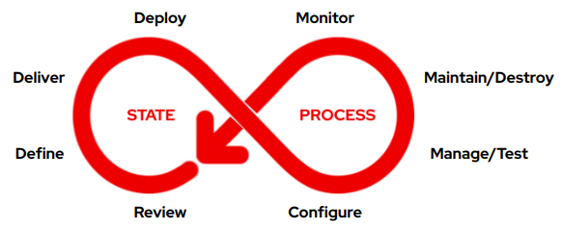
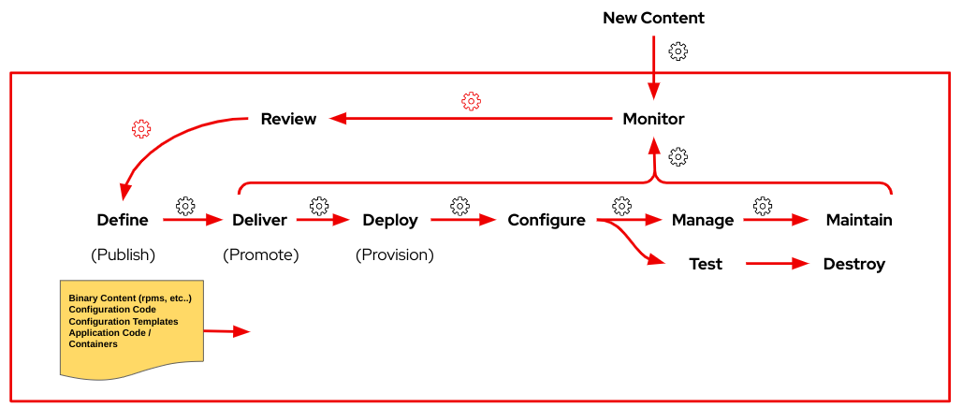
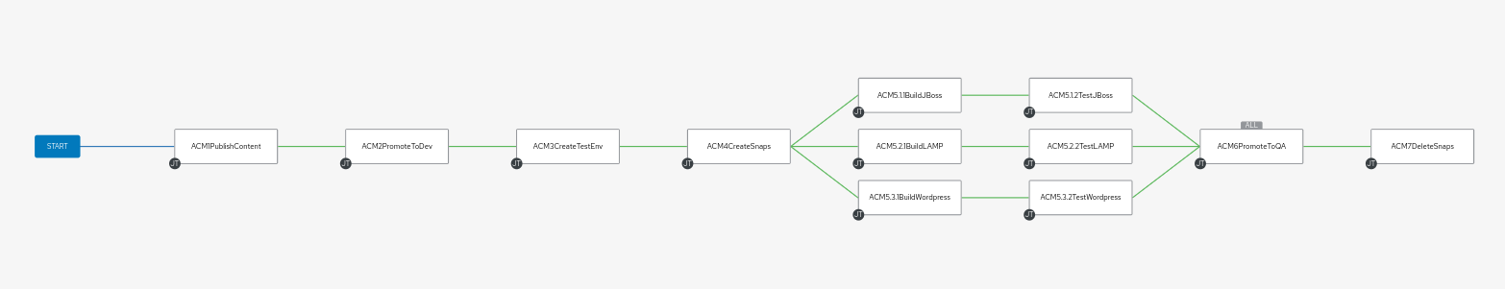
Red Hat Infrastructure Standard Adoption Model
The RH-ISAM Journey takes your SOE…
From Concept…
To Model…
To Pipeline…

Slide 31



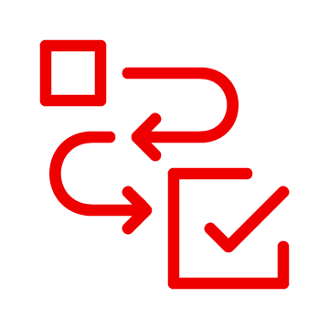
The Business Value of RHEL Standardization
Articulating the Value of Automation + RHEL SOEs
Consistently build and test in the same environment, accelerating delivery for AppDev
HW and SW vendor certs extend mkt reach
Platform ubiquity - RHEL anywhere, any cloud
Streamlined management at scale, across environments
Automated identification and remediation of vulnerabilities
Predictive analytics that turn break-fixes into scheduled actions
Budget
OpEx
Revenue
AppDev productivity
NPS
Market share
TANGIBLE
Revenue Growth
Cost Optimization
Productivity
TOP LINE
BOTTOM LINE
Strategic
Goals
Risk Mngmnt
Security posture & stability
Remediation
Downtime
Innovation
Turnover
Burn-out
Largest catalog of certified partners and ISVs
Integrations with fleet management tools
Toil reduced through standardization
Power of Open Source community
Secure software supply chain
Automated detection of config drift
Faster tracking of system patch status
Gov and public sector certifications
Audit reports generation
INTANGIBLE
*includes Insights
Notes:
[Content Owner]: Mike Savage
Automation of Standardized RHEL Operating Environments unlocks these business objectives!
The Value Map for RHEL aligns to the same four quadrant view we explored in the previous slide, but you will notice has specific details regarding the technical solutions to business value, as well as measurable business impact metrics, like boosting productivity. If we were to orient ourselves in this map, and look at Cost Optimization for example, the KPIs are directly related to aspects of the solution that unlock them.
We understand the power of RHEL, but it can be difficult to articulate this to non-technical stakeholders, and you should leverage this value map in your conversations with your customers.
The intent of this four quadrant slide, specific to RHEL is to enable you to become a trust partner that offers technology to directly affect your customers business performance.
By understanding what your customer personas value, and speaking directly to those objectives, you will demonstrate credibility in demonstrating the internal and external factors that impact their business, and can supplement this messaging by demonstrating examples of where we have worked with “like” customers implementing best in class technology solutions to help them grow and operate more efficiently. The technical solution enablers in the quadrants further illustrate how Red Hat can help deliver on the desired business outcomes, and helps your customer understand why RHEL is important to their business.
Now let’s take a peek at how the VITO toolkit to help you customize your business value messaging of RHEL to your customers, and uplevel your customer conversations around Expanding Workloads to the Cloud.
Strategic - CEO
Revenue - LOBs
Cost - CTO/CIO
Risk - CISO/CFO

Slide 32
Platform Is Frictionless
Continuous Delivery Lifecycle
SELF
PROVISIONING
ENVIRONMENT
STANDARDIZATION
AUTO
SCALING
AUTOMATED TESTING
DEV
QA
UAT
PROD
CONTINUOUSLY DELIVER EVERYTHING
SPEC / REQUIREMENT
BUILD
EVERYTHING as CODE
AUTOMATION
CONTINUOUS
INTEGRATION
SECURE
COMPLIANT
MONITORING
PRODUCT MANAGER
DEVELOPERS
ARCHITECTS
TEST
ENGINEERS
OPERATIONS
PERSONNEL
Notes:
[Content Owner]: Paul Armstrong
Talk about containerization and CI/CD Process .
examples : Push Button Infrastructure (PBI) , Workflow Modernization, Container Adoption Framework
This slide is from another presentation on how Red Hat drives devOps/gitOps methodology and part of our Value to our customers. https://docs.google.com/presentation/d/1_HIWmkNcg0uCh1z4mn7qA3KP_YbQDXZdbElHBx11HCY
More broadly this describes how we as IT practitioners need to look at all aspects of our delivery of … really, anything. Whether this is a function, a feature, or a complete solution like an ERP system or Web Marketplace platform.
Each stakeholder has a part in the process, each stakeholder needs to view the “component” being built/delivered through appropriate lenses to achieve the desired outcome.
Everything as Code - we are more reliable, more flexible and more agile when we can declaratively state our intention for a “component” and use code to deliver it. This enables…
Automation - we are more streamlined, more responsive to change, consistent and can scale faster (up or down) when we are able to automate the pipelines used to deliver our components.
Continuous Integration - is achieved when we are able to join one or more of these pipelines together to deliver on a larger goal. This will be important in the next section.
Secure / Compliant - viewing activities at each stage through a lens focused on ensuring security and compliance (to standards, regulations, and guidance) enables the process to simplify and cover complex requirements.
Monitoring - ensuring all stakeholders are provided with timely and accurate feedback within the process allows for incremental improvements or course corrections to ensure goals are achieved even in a rapidly changing business environment.
Any box within this diagram contains this same cycle. As you drill in to environment standardization as an example. (Next Slide)

Slide 33
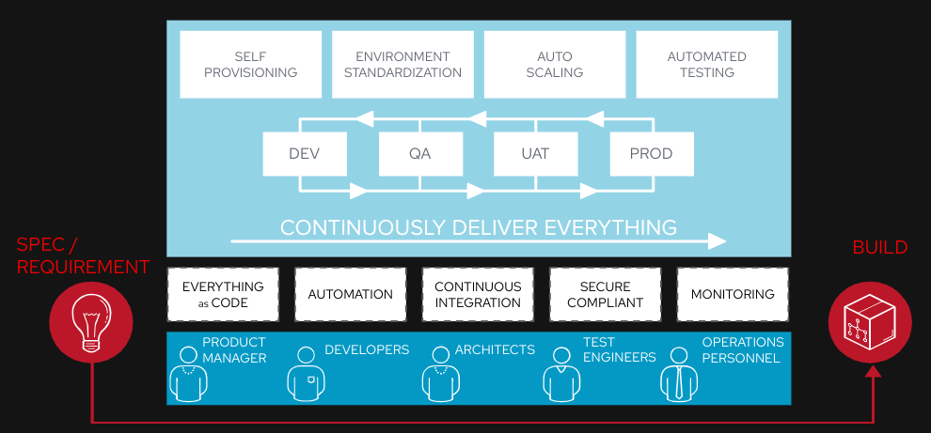
Platform Is Frictionless
Continuous Delivery Lifecycle
SELF
PROVISIONING
ENVIRONMENT
STANDARDIZATION
AUTO
SCALING
AUTOMATED TESTING
DEV
QA
UAT
PROD
CONTINUOUSLY DELIVER EVERYTHING
SPEC / REQUIREMENT
BUILD
EVERYTHING as CODE
AUTOMATION
CONTINUOUS
INTEGRATION
SECURE
COMPLIANT
MONITORING
PRODUCT MANAGER
DEVELOPERS
ARCHITECTS
TEST
ENGINEERS
OPERATIONS
PERSONNEL
Notes:
[Content Owner]: Paul Armstrong
Any box within this diagram contains this same cycle. As you drill in to environment standardization as an example. (This Slide)
You see that process repeats itself on that scale in a Mandelbrot-esque way. We cycle through the same Dev - QA - UAT - Prod feedback circuit for continuously delivering improvement.
We are striving to make each pipeline capable of self provisioning, standardization, scalability and automated testing / attestation

Slide 34
Platform Is Frictionless
Continuous Delivery Lifecycle
SELF
PROVISIONING
ENVIRONMENT
STANDARDIZATION
AUTO
SCALING
AUTOMATED TESTING
DEV
QA
UAT
PROD
CONTINUOUSLY DELIVER EVERYTHING
SPEC / REQUIREMENT
BUILD
EVERYTHING as CODE
AUTOMATION
CONTINUOUS
INTEGRATION
SECURE
COMPLIANT
MONITORING
PRODUCT MANAGER
DEVELOPERS
ARCHITECTS
TEST
ENGINEERS
OPERATIONS
PERSONNEL
Notes:
[Content Owner]: Paul Armstrong
At any scope in our process, we apply the same principals.
The tools may be different. The component delivered is different, but the highlevel process is the same.
Its turtles all the way down…

Slide 35
Where does the RH-ISAM fit in the Strategy?
Notes:
[Content Owner]: Paul Armstrong

Slide 36
Capability Matrix for Flight Path
Red Hat Infrastructure Standard Adoption Model
Inflection Point
Platform Prep
Platform Delivery
Overall maturity increases up and to the right Copy this slide and use the colour fill key below to generate your map.
CI Framework
RH-ISAM
Observability Pub/Sub
Security Services Provisioning
Platform Workflow
Declarative Infrastructure
Operator Certification
Chargebacks
Automated Governance
Network Provisioning
Runbook Automation
Platform Security
Sidecar Integration
Resiliency Validation
Application Lifecycle Automation
Platform Bill of Materials
Storage Provisioning
Provisioning Mgmt
Prod-like Sandbox
Secrets Management
Build Pipelines
Disaster Recovery / Active Failover
FinOps
Software Bill of Materials
Compute Provisioning
Version Control
Single Containers
Storage/Network integration
Deployment Integration
Fleet Management
Zero Trust
Custom Policy Enforcement
Config Mgmt
Automation Workflow
Dev Workstations
Workload Analysis
Image Ingestion
SRE Patterns
Service Mesh
Reg. Auditing & Reporting
Foundational Automation
Infrastructure Automation
Container Development
Container Platform Essentials
Workload Intake Acceleration
Platform Services
Advanced Capabilities
Regulatory Support
Key:
Under Performing
Rudimentary
Developing
Acceptable
Advanced
Leading
Adapted From: Flight Path End to End by Adam Seeley and Bob Mader
Notes:
[Content Owner]: Paul Armstrong
Adapted from Flight Path End to End by Adam Seeley and Bob Mader
This slide represents the Stages for the Flight Path journey and the capabilities needed within the organization infrastructure in order for that stage to be considered successfully completed. This is not to imply that all of the capabilities in each stage must be a leading level before proceeding to the next stage but rather a measure of overall capability and likelihood of success. The goal of the chart is to allow the leadership team to gauge current overall success of the effort by having stakeholders estimate capability across the teams that make up the effort.
The Red Hat Infrastructure Standard components map into the first two stacks necessary in building out the capability matrix.
Copy this slide for the initial review of capabilities and set the fill colour of each capability to create a capability map/matrix. At each subsequent review copy the previous reviews map and update it for the current review to generate a timeline of success.

Slide 37
Cloud Native Adoption ROI
Entering at the wrong point in the continuum == failure
Red Hat Infrastructure Standard Adoption Model
RH-ISAM
Network
Automation
Secured Supply Chain
IaC
Builds
Multi-Cloud
Server Provisioning
Zero Trust
GitOps
CI/CD Scaffolding
Return on Investment
In-Place Upgrades
OpenShift
Enterprise Pipelines
Migration Factories
OpenShift + ACM + ACS
Developer
Workstations
Container Dev Environment
Entry Automation | Infra automation | Container Development | Container Platform Essentials | Workload Intake Acceleration | Platform Services | Advanced Capabilities | Regulatory Support
Time
Adapted From: Flight Path End to End by Adam Seeley and Bob Mader
Notes:
Plotting ROI over time along the necessary path of skills adoption needed to reach a high level of maturity in mitigating to a cloud native model for your organization, you can see that there is huge initial benefit in ensuring Infrastructure Automation adoption. This hones the basic skills in operations teams necessary to be successful in delivering organisation wide support for container platform, platform services and advanced capabilities.
In our experience, entering this continuum at a point too far along the timeline (i.e. jumping in) frequently leads to failure. We have tried jumping in with models other than flight path where appropriate buildup of skills has not taken place, only to have projects end up in the boneyard. Getting Automation and Standardization done right is imperative.

Slide 38
Combining Flight Path with the Curve
Build-up of RHEL, Ansible and OpenShift platform capabilities that are used to accelerate application adoption.
Red Hat Infrastructure Standard Adoption Model
RH-ISAM
Network
Automation
Secured Supply Chain
Prod-like Sandbox
IaC
Builds
Security patching
Multi-Cloud
Server Provisioning
Product upgrades
Zero Trust
Dynamic scaling
GitOps
CI/CD Scaffolding
Return on Investment
Ephemeral environment
In-Place Upgrades
Container Dev Environment
OpenShift
Automated deployments
Developer
Workstations
Enterprise grade environment
Configuration Management
Configuration
Non-Production
Lifecycle Management
GitOps
Production Environments
Self Service
Scale
Entry Automation | Infra automation | Container Development | Container Platform Essentials | Workload Intake Acceleration | Platform Services | Advanced Capabilities | Regulatory Support
Time
Adapted From: Flight Path End to End by Adam Seeley and Bob Mader
Notes:
If we take that same plot and layer a development container adoption journey along the timeline and ensure that we enter with this technology at the suitable point we can continue to generate high ROI as we drive through some of the challenging infrastructure learning that takes place in adoption a containerized application development platform. Stakeholders in the application delivery ecosystem start to reap the benefits of the ability to effectively deliver infrastructure.

Slide 39
Red Hat Infrastructure Standard Adoption Model
Red Hat Infrastructure Standard Adoption Model
A modular framework to support customer infrastructure modernisation - click on components for more information
Migrate to RHEL
Analysing workloads on non-RHEL platforms (inc. legacy UNIX, Windows, +Linux), creating a migration strategy, replatforming candidate workloads on RHEL using a migration factory approach.
Convert to RHEL
Analysing and converting in-place rpm based operating systems to RHEL.
This allows in-place upgrade to eliminate technical debt.
Upgrade to RHEL8 or 9
Analysis and in-place upgrading servers running older versions of RHEL to RHEL8 or RHEL9.
Modernize Virtualization
Deploy New Virtualization Platforms and migrate workloads onto it.
Modernize Application Delivery
Analysis and migration of applications running any operating system to a standard methodology
Deliver All Standard Workloads through Automation
Plugable Solutions
at least one + Contribute
Implement the Red Hat Infrastructure Standard Platform
Required :building a secure, stable, manageable, automated RHEL platform to scale workloads on
Foundational
Navigate to the Red Hat Infrastructure Standard
Engage with Red Hat to fully determine requirements, operational readiness.
* This component is mandatory unless the customer already has a RHEL Standard Operating Environment in place.
Notes:
[Content Owner: Martijn Ten Heuvel and Paul Armstrong]

Slide 40
Discovery
Why is this important?
Who will be responsible?
Who will be involved in execution?
What is the task we need to execute?
What are target applications?
Pilot
To Be
Create and build modernisation paths
Deploy automation tools
Design and deploy SOE
Test modernisation of workloads Use side by side comparisons, use dark launches, test deployments
Define the factory
Define day 2 operations and other standards
Automate everything
Navigate
Scale
Review the current environment and integrations, dependencies
Review applications and review systems running these applications, identify and commit to the order of migrations
Analyse where these applications can go to: RHEL, containers, bin, and so on.
High level design for the new RHEL environment, including security model based on HBAC and RBAC and central directory services
Common understanding of the task at hand
Deploy the modernisation factory
Plan for modernisation
Modernize remaining systems
Implement responsibilities
Refactor and extend automation
As is
Notes:
We use a journeymap to identify where we are and where need to go. We are in the discovery phase today, ready to move to the navigate phase.
Discovery for us is to identify why and who, whereas during the Navigate we determine the how.
Once we have an idea on the how, we can start a pilot phase, where we start to create and build the modernisation paths, deploy the platform and tools and so on.

Slide 41
RH-ISAM in a Hybrid Cloud Deployment
Red Hat Infrastructure Standard Adoption Model
Red Hat Infrastructure Standard
Common Code and Process Across All Environments
Red Hat Hybrid Cloud
Services
Security/SSO
Lifecycle
Automation
Compliance
Configuration
Native AD Trust
Data Center 1
Data Center 2
Cloud 1
Region 1
Cloud 1
Region 2
Cloud 2
Cloud 3
Notes:
[Content Owner]: Paul Armstrong, Mike Savage
Abstracting Differences in the various data centers and cloud delivers Consistent Process and Reduces the impact of Change.
Automation can define processes to deliver content; define and deploy systems; check compliance and manage configuration; all by simply changing the variable values and not the underlying code.
As an example, using image builder we can define a cloud image from RHEL8 built from a Satellite content view. We can deploy that to AWS, Azure, VMware or OpenStack based simply on specifying the target connection information. We can then have Satellite deploy the image, again, by simply specifying the Compute Resource. Ansible can manage the host configuration no matter where it resides. When the image is deployed and configured for IdM integration, all the centralized policy is implemented on the system, again simply and easily.

Slide 42
Why should Red Hat want to do this?
Red Hat Infrastructure Standard Adoption Model
Consistency
Leverage Investment
Onboard to Insights
Expand
Allow our Red Hat customers to transition to cloud with a minimum of disruption of existing Linux management workflows and tools. Get customer adopting modern infrastructure and code practices that are necessary with OpenShift.
Close the gap to cloud native.
Leverage the existing experience and bias of operations teams for Red Hat product.
Foundation for migration service day 2 / N
See MTH slides
Maintain installed base and capture cloud share. Accelerate cloud adoption.
Accelerate modernization
Insights becomes an integral part of the solution ecosystem.
Tie console dot into the provisioning lifecycle of the customer to add value.
Use satellite gateway function to overcome objections (cost and security concerns)
Differentiate from other Linux variants and make our solution more sticky.
Closely tie testing, delivery and maintenance of all systems to Ansible.
Use ansible and satellite as the lingua franca for automating traditional linux systems across multiple platforms and clouds.
Further open hybrid cloud message.
Upsell Ansible and Openshift cloud offerings.
Notes:
[Content Owner]: Paul Armstrong

Slide 43
The Tools We Use
Red Hat Infrastructure Standard Adoption Model
A quick introduction to the elements of the Red Hat Infrastructure Standard
Notes:
[Content Owner]: Paul Armstrong

Slide 44
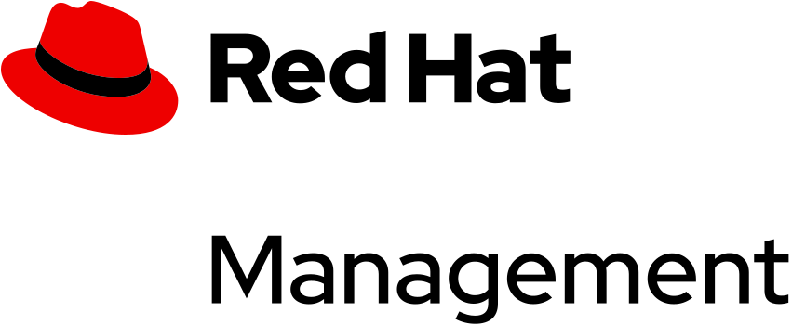

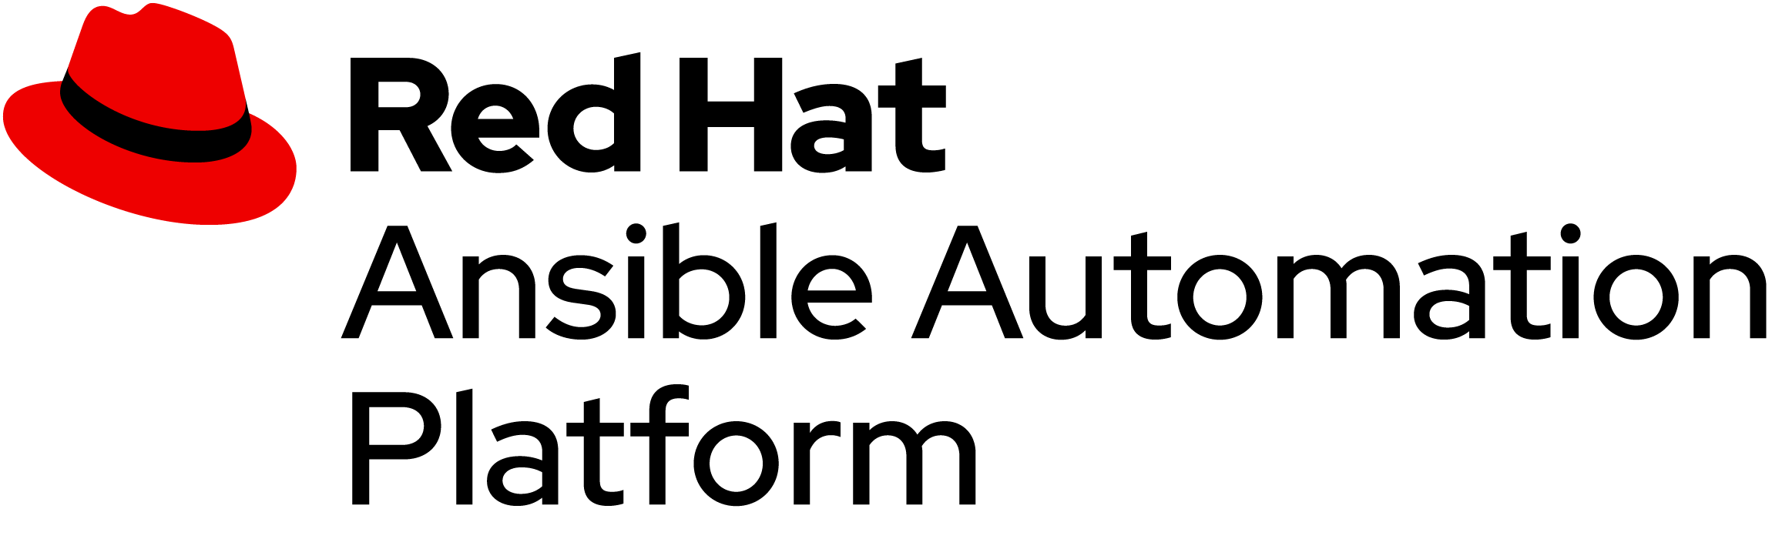

Red Hat Management Portfolio
Red Hat Infrastructure Standard Adoption Model
Identity
MANAGE LINUX IDENTITY AND POLICY
Single Sign-On, sudo, RBAC, HBAC, SELinux Policy, identity mapping, native AD Integration.
Included with Red Hat Enterprise Linux.
FLEXIBILITY TO MANAGE RED HAT ENTERPRISE LINUX
Secure software supply chain and content lifecycle on-premise or in the cloud with Satellite and Red Hat Hybrid Cloud Console
AUTOMATION FOR EVERYONE
Simple, Powerful, Agentless
Cross Platform
Systems, Network, Storage, Cloud
Human Readable
PREVENT CRITICAL ISSUES BEFORE THEY OCCUR
Red Hat “Insights” Included with Red Hat Enterprise Linux.
Red Hat Hybrid Cloud Console
Red Hat Image Builder
Notes:
[Content Owner]: Paul Armstrong
These are our core tools.

Slide 45
RH-ISAM in a Hybrid Cloud Deployment
Red Hat Infrastructure Standard Adoption Model
Red Hat Infrastructure Standard
Common Code and Process Across All Environments
Red Hat Hybrid Cloud
Services
Security/SSO
Lifecycle
Automation
Compliance
Configuration
Native AD Trust
Data Center 1
Data Center 2
Cloud 1
Region 1
Cloud 1
Region 2
Cloud 2
Cloud 3
Notes:
[Content Owner]: Paul Armstrong, Mike Savage
Abstracting Differences in the various data centers and cloud delivers Consistent Process and Reduces the impact of Change.
Automation can define processes to deliver content; define and deploy systems; check compliance and manage configuration; all by simply changing the variable values and not the underlying code.
As an example, using image builder we can define a cloud image from RHEL8 built from a Satellite content view. We can deploy that to AWS, Azure, VMware or OpenStack based simply on specifying the target connection information. We can then have Satellite deploy the image, again, by simply specifying the Compute Resource. Ansible can manage the host configuration no matter where it resides. When the image is deployed and configured for IdM integration, all the centralized policy is implemented on the system, again simply and easily.

Slide 46
What is Red Hat Identity Management?
Red Hat Infrastructure Standard Adoption Model
Red Hat Identity Management is a centralized authentication management system for Linux. Identity Management is to Linux what AD is to Windows.
centrally manage identity stores, authentication, policies, and authorization policies in a Linux-based domain.
natively integrate with Active Directory through a trust relationship
underlying technologies are well-established on Linux systems and trusted by Linux administrators (kerberos, bind, ldaps, sudo, etc..)
supports OIDC integration
integrates with other Red Hat Technology
Ansible Automation Platform
OpenShift Container Platform
OpenStack Platform
Satellite
Single Sign-On (e.g. all middleware through keycloak)
Notes:
[Content Owner]: Paul Armstrong

Slide 47
What is Red Hat Satellite?
Red Hat Infrastructure Standard Adoption Model
Red Hat Satellite is a system management solution
deploy, configure, and maintain your systems across physical, virtual, and cloud environments.
provision, remotely manage and monitor deployments with a single, centralized tool.
Red Hat Satellite Server
synchronize content from the Red Hat CDN and other sources
fine-grained life cycle management, RBAC, advanced GUI, CLI, or API access.
Red Hat Satellite Capsule Server
mirrors content from Satellite Server to various geographical locations.
pull content and configuration from local Capsule vs. central Satellite Server.
provides localized services such as DHCP, DNS, TFTP, Ansible, Discovery and more
scale your Red Hat Satellite infrastructure as the number of managed systems increases
Notes:
[Content Owner]: Paul Armstrong

Slide 48
What is Ansible Automation Platform?
Red Hat Infrastructure Standard Adoption Model
Red Hat Ansible Automation Platform is an enterprise framework for building and operating IT automation at scale, from bare metal servers to hybrid cloud and the edge.
It enables users across an organization to create, share, and manage automation—from development and operations to security and network teams.
A very large ecosystem of partners provide modules and roles for Ansible Automation Platform to manage their technology. From Azure to VMware to AWS and SAP, technology companies providing hardware, networking and software provide certified ansible code for managing their infrastructure.
Notes:
[Content Owner]: Paul Armstrong

Slide 49
What is Red Hat Hybrid Cloud Console?
Red Hat Infrastructure Standard Adoption Model
Red Hat Hybrid Cloud Console is
a managed service
continuously analyzes platforms and applications
helps enterprises better manage hybrid cloud environments
included with Red Hat subscriptions
uses predictive analytics and deep domain expertise to reduce complex operational tasks
including identifying security and performance risks, tracking licenses, and managing costs.
Focuses on areas of operations, security, and business, Insights proactively alerts administrators and stakeholders before an outage, security event, or overspending occurs. By helping teams stay ahead of critical operational issues, Insights frees up resources to focus on the delivery of new features and innovation.
Notes:
[Content Owner]: Paul Armstrong

Slide 50
What is Red Hat Image Builder?
Red Hat Infrastructure Standard Adoption Model
Red Hat Image Builder
creates customized system images of RHEL, including system images prepared:
Azure, AWS and other cloud providers
VM images for KVM, OpenShift Virtualization, VMware, and HyperV
RPM-OSTree images for RHEL for Edge and other immutable image use cases
automatically handles the setup details for each output type
can push to target platforms
easier to use and faster to work with than manual methods of image creation.
composer-cli, RHEL web console, or through automation
Notes:
[Content Owner]: Paul Armstrong

Slide 51
Deploying the Standard Operating Environment
Infrastructure
Red Hat Infrastructure Standard Adoption Model
Notes:
[Content Owner]: Paul Armstrong

Slide 52
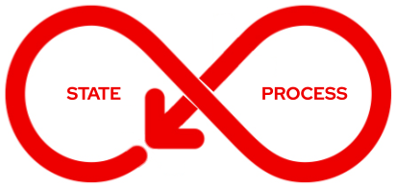
Model, Conditions, Control
Red Hat Infrastructure Standard Adoption Model
Deploy
Monitor
Deliver
Maintain/Destroy
Define
Manage/Test
Review
Configure
Goal: Deliver a pipeline for one or more models
Notes:
[Content Owner]: Paul Armstrong
When dev ops models are discussed they tend to focus a lot on the developer side of the model. The standard operating environment is critical for all those elements that run on top. Developer build systems, orchestration systems, production system creation and testing – all the elements that create the environment on which a devops model runs.
Each Standard Operating Environment model has a set of conditions that include: System content that is required / allowed, system configuration that is required, security configuration, deployment processes, application or runtime configuration, management processes, maintenance process/workflows, monitoring, logging, reporting, revision/recycling/retirement, etc.. and our automation provides the control.

Slide 53


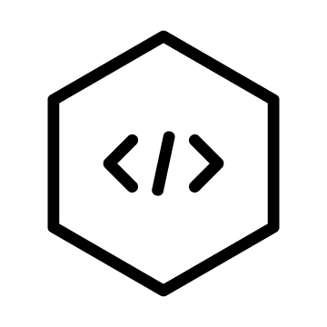


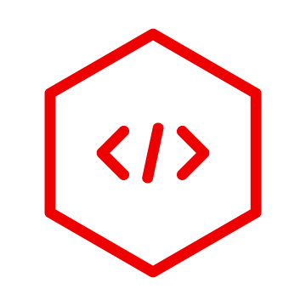
Provisioning SOE Systems
Red Hat Infrastructure Standard Adoption Model
Curate Content
All of these services are delivered across a Hybrid Cloud Environment using standardized workflows
Identity Enrollment & Authentication
Provisioning Automation
Pre- and Post-Provisioning Configuration
Maintenance Automation
Compliance Definition, Reporting, Remediation
Vulnerability Analysis, Remediation
Kubevirt
Hypervisor
Cloud
Bare Metal
Standardized Image Delivery
Any Cloud or Hypervisor Image
Notes:
[Content Owner]: Paul Armstrong

Slide 54


Provisioning SOE Systems
Red Hat Infrastructure Standard Adoption Model
Red Hat Identity Management
Using tooling built and tested to work together with your platforms.
Red Hat Satellite
Ansible Automation Platform
Future-Proof infrastructure for any cloud or hypervisor Image
Red Hat Hybrid Cloud Console
Kubevirt
Hypervisor
Cloud
Bare Metal
Red Hat Image Builder
Notes:
[Content Owner]: Paul Armstrong

Slide 55
Deploying the Infrastructure with Ansible Automation Platform
Red Hat Infrastructure Standard Adoption Model

Slide 56
RH-IS Powered By Ansible Automation
Red Hat Infrastructure Standard Adoption Model
Red Hat Certified Collections from Red Hat Automation Hub
Configure IdM Masters, Replicas and Clients
redhat.rhel_idm
redhat.satellite
redhat.satellite_operations
redhat.rhel_system_roles
Deploy Satellite and Capsule
Create and Configure all Satellite objects, and settings Deploy Systems
ansible.*
ansible.controller
ansible.tower
Configure Ansible Automation Platform
Create or Import Assets
Notes:
[Content Owner]: Paul Armstrong

Slide 57







RH-IS Powered By Ansible Automation
Red Hat Infrastructure Standard Adoption Model
Complete control of your authentication and authorization
redhat.rhel_idm
Users, Groups, Hosts, Groups of Hosts, Services
Certificates, OTP Tokens, Certificate Identity Mapping
Host-based Access Control, Password Policy, SELinux User Mapping, Sudo Policy
Notes:
[Content Owner]: Paul Armstrong

Slide 58
RH-IS Powered By Ansible Automation
Red Hat Infrastructure Standard Adoption Model
Deploy, analyze, report and remediate
redhat.satellite
redhat.satellite_operations
redhat.rhel_system_roles
Domains, Realms, Subnets,
Compute Profiles
Compute Resources, Discovery
Operating Systems, Media, Provisioning Templates, Partition Tables, Job Templates, Template Synchronization from Git Repos
Content Sources, Synchronization, Lifecycle Environments, Content Views and Composites, etc..
Notes:
[Content Owner]: Paul Armstrong

Slide 59

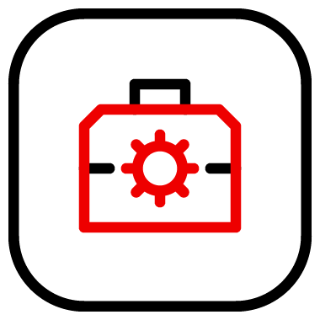


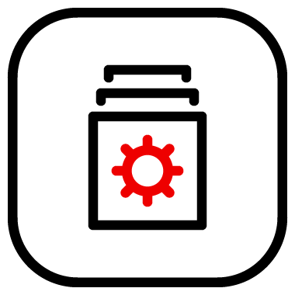
RH-IS Powered By Ansible Automation
Red Hat Infrastructure Standard Adoption Model
Deploy, analyze, report and remediate
ansible.*
ansible.controller
ansible.tower
Templates, Workflows, Credentials, Projects, Inventories
Schedules, Authentication, Management Jobs
Instances, Instance Groups, Execution Environments
Import and Export any Assets
Content Collections
Notes:
[Content Owner]: Paul Armstrong

Slide 60
Builder Demo
Red Hat Infrastructure Standard Adoption Model
rhis-builder on Red Hat Community of Practice github

Slide 61
Delivering the Standard Operating Environment
Infrastructure
Red Hat Infrastructure Standard Adoption Model
Notes:
[Content Owner]: Paul Armstrong

Slide 62



We can deliver this via our Services Organization.
Red Hat Infrastructure Standard Adoption Model
High-level task list
Discover and design:
Review existing or Design new.
Lead interactive architecture workshop to identify systems, environments, roles, and representative operational tasks
Define and document Red Hat Infrastructure Standard for your environment, server roles and groups, and role-based access control (RBAC) model for multi-tenant operations
Deploy:
Deploy/Configure the system services determined by Discover and Design
Integrate with infrastructure services (e.g. PXE, VMware, etc..) for system provisioning
Organize targeted systems
Create end-to-end, reusable system provisioning processes
Establish Automated configuration and content management
Build and enable RBAC model to support authorization and operations.
Establish process and approach to develop, test, and iterate Standard Operating Environment
Enable:
Provide side-by-side mentoring throughout the engagement
Deliver and review architectural and operational documentation
Notes:
[Content Owner]: Paul Armstrong

Slide 63
Option 1 - Simplified Deployment.
Red Hat Infrastructure Standard Adoption Model
High-level task list
FOCUS: Install the solution, transfer critical knowledge to the customer
Review existing systems. Review stated requirements, Identify deployment gaps
Configure systems - AAP, Satellite, Identity Management
Limited use of our automated deployment tooling
No discussion of automated deployment tooling configuration or maintenance
Establish automated system deployment with single compute resource
Establish integration with Idm during deployment.
Establish AAP callback integration.
Establish automated publishing and promotion of CV/CCV for single SOE.
Establish an automated pipeline for a single SOE as per RH-ISAM model.
Provide side-by-side mentoring throughout the engagement
Deliver and review architectural and operational documentation
Notes:
[Content Owner]: Paul Armstrong

Slide 64
Option 2 - Automated Deployment.
Red Hat Infrastructure Standard Adoption Model
High-level task list
FOCUS: Growing customer sophistication to include repeatability and infrastructure as code practices
All of the elements of Option 1 plus
Introduction to automated tooling
Help customer establish a library of configurations integrated with SCC (git)
Establish good practice on automation code testing
Establish good practice on automation code publication process
Transfer knowledge to aid customer in expanding IaC practice
Work side by side to develop 2nd SOE pipeline
Notes:
[Content Owner]: Paul Armstrong

Slide 65
Option 3 - RH-ISAM Residency
Red Hat Infrastructure Standard Adoption Model
High-level task list
FOCUS: Deliver in-depth training to a core group of customer professionals with to goal of creating a perpetuating training model for all customer Linux engineers (Dojo).
All of the elements of Option 1 and Option 2 plus
Focused 2 month program - 4 x 2 week sprints
In depth training on automated deployment tooling.
Extend deployment to remote datacenters and cloud
Establish multiple compute resources - at least 1 cloud CR
Establish a library of configurations integrated with SCC (git)
Establish automation code lifecycle.
Customer developed SOE pipelines by end of week 6
Team demonstration
Selection and Rotation plan for new team members
Notes:
[Content Owner]: Paul Armstrong

Slide 66
A Standard Operating Environment
Red Hat Infrastructure Standard Adoption Model
AN EXAMPLE
Notes:
[Content Owner]: Paul Armstrong

Slide 67
Remember…
Model, Conditions, Control
Red Hat Infrastructure Standard Adoption Model
Deploy
Monitor
Deliver
Maintain/Destroy
Define
Manage/Test
Review
Configure
Goal: Deliver a pipeline for one or more models
Notes:
[Content Owner]: Paul Armstrong
When dev ops models are discussed they tend to focus a lot on the developer side of the model. The standard operating environment is critical for all those elements that run on top. Developer build systems, orchestration systems, production system creation and testing – all the elements that create the environment on which a devops model runs.
Each Standard Operating Environment model has a set of conditions that include: System content that is required / allowed, system configuration that is required, security configuration, deployment processes, application or runtime configuration, management processes, maintenance process/workflows, monitoring, logging, reporting, revision/recycling/retirement, etc..

Slide 68

Seeing it as a pipeline model
Red Hat Infrastructure Standard Adoption Model
New Content
New Code, Revisions, Errata,
Vulnerability Data, Configuration Recommendations
Review
Monitor
Define
Deliver
Deploy
Configure
Manage
Maintain
(Publish)
(Promote)
(Provision)
Test
Destroy
Binary Content (rpms, etc..)
Configuration Code
Configuration Templates
Application Code / Containers
A generalized SOE lifecycle
Notes:
[Content Owner]: Paul Armstrong
With Animations
When dev ops models are discussed they tend to focus a lot on the developer side of the model. The standard operating environment is critical for all those elements that run on top. Developer build systems, orchestration systems, production system creation and testing – all the elements that create the environment on which a devops model runs.
Each Standard Operating Environment model has a set of conditions that include: System content that is required / allowed, system configuration that is required, security configuration, deployment processes, application or runtime configuration, management processes, maintenance process/workflows, monitoring, logging, reporting, revision/recycling/retirement, etc..

Slide 69
Seeing it as a pipeline model
Red Hat Infrastructure Standard Adoption Model
New Content
New Code, Revisions, Errata,
Vulnerability Data, Configuration Recommendations
Review
Monitor
Define
Deliver
Deploy
Configure
Manage
Maintain
(Publish)
(Promote)
(Provision)
Test
Destroy
Binary Content (rpms, etc..)
Configuration Code
Configuration Templates
Application Code / Containers
A generalized SOE lifecycle
Notes:
[Content Owner]: Paul Armstrong
Without Animations
When dev ops models are discussed they tend to focus a lot on the developer side of the model. The standard operating environment is critical for all those elements that run on top. Developer build systems, orchestration systems, production system creation and testing – all the elements that create the environment on which a devops model runs.
Each Standard Operating Environment model has a set of conditions that include: System content that is required / allowed, system configuration that is required, security configuration, deployment processes, application or runtime configuration, management processes, maintenance process/workflows, monitoring, logging, reporting, revision/recycling/retirement, etc..

Slide 70
Seeing it as a series of pipeline models
Red Hat Infrastructure Standard Adoption Model
New Content
Development
We connect Lifecycle Environments into a path and we promote our artifacts along that path
Rev
Mon
Def
Del
Dep
Con
Man
Main
Automated Delivery
Test
Dest
Binary Content (rpms, etc..)
Configuration Code
Configuration Templates
Application Code / Containers
New Content
Qualification
Rev
Mon
Feedback
Test Results
Error Reports
Dep
Con
Man
Main
Test
Dest
next…
Binary Content (rpms, etc..)
Configuration Code
Configuration Templates
Application Code / Containers
New Content
Notes:
[Content Owner]: Paul Armstrong
When dev ops models are discussed they tend to focus a lot on the developer side of the model. The standard operating environment is critical for all those elements that run on top. Developer build systems, orchestration systems, production system creation and testing – all the elements that create the environment on which a devops model runs.
Each Standard Operating Environment model has a set of conditions that include: System content that is required / allowed, system configuration that is required, security configuration, deployment processes, application or runtime configuration, management processes, maintenance process/workflows, monitoring, logging, reporting, revision/recycling/retirement, etc..

Slide 71
Red Hat Infrastructure Standard Adoption Model
Define
Deliver
Deploy
Notes:
[Content Owner]: Paul Armstrong
Part of the state of the system is the content that is available to the system.
What software is able to be deployed and when.
What lifecycle does that content traverse.
Using Satellite we can define that content quite cleanly.

Slide 72




Red Hat Infrastructure Standard Adoption Model
Content Management
Lifecycle Management
Host Content Management
Retirement Lifecycle
Secure Content Distribution
Production Lifecycle
Production Servers
Qualification Lifecycle
QA Servers
Content
Filtering
Development Lifecycle
Development Servers
Version 1
Other Dev Content
Standard Image Defn
Version 1
Standard Image Defn
Standard Image Defn
Content Baseline
Content Access
Content Delivery
Notes:
[Content Owner]: Paul Armstrong
Part of the state of the system is the content that is available to the system.
What software is able to be deployed and when.
What lifecycle does that content traverse.
Using Satellite we can define that content quite cleanly.

Slide 73
Red Hat Infrastructure Standard Adoption Model
Content Management
Lifecycle Management
Host Content Management
Retirement Lifecycle
Secure Content Distribution
Production Lifecycle
Production Servers
Version 1
Qualification Lifecycle
QA Servers
Version 1
Other QA Content
Version 1
Content
Filtering
Version 2
Development Lifecycle
Development Servers
Version 3
Other Dev Content
Standard Image Defn
Version 3
Standard Image Defn
Standard Image Defn
Content Baseline
Content Access
Content Delivery
Notes:
[Content Owner]: Paul Armstrong
Part of the state of the system is the content that is available to the system.
What software is able to be deployed and when.
What lifecycle does that content traverse.
Using Satellite we can define that content quite cleanly.

Slide 74
Red Hat Infrastructure Standard Adoption Model
Content Management
Lifecycle Management
Host Content Management
Retirement Lifecycle
Secure Content Distribution
Version 1
Production Lifecycle
Production Servers
Other Prod
Content
Version 2
Version 3
Qualification Lifecycle
QA Servers
Version 3
Other QA Content
Version 3
Content
Filtering
Version 4
Development Lifecycle
Development Servers
Version 5
Other Dev Content
Standard Image Defn
Version 5
Standard Image Defn
Standard Image Defn
Content Baseline
Content Access
Content Delivery
Notes:
[Content Owner]: Paul Armstrong
Part of the state of the system is the content that is available to the system.
What software is able to be deployed and when.
What lifecycle does that content traverse.
Using Satellite we can define that content quite cleanly.

Slide 75
Red Hat Infrastructure Standard Adoption Model
Content Management
Lifecycle Management
Host Content Management
Retirement Lifecycle
SOE_RHEL8
v21.0
2022-05
Production Lifecycle
Production Servers
RHEL 9 BaseOS
RHEL 9 AppStream
Custom Repo
Other Content Views
Library
SOE_RHEL8
v22.0
2022-06
SOE_RHEL8
v22.0
2022-06
RHEL 8 BaseOS
RHEL 8 AppStream
Satellite Tools
37242 Packages
3326 Errata
Qualification Lifecycle
QA Servers
SOE_RHEL8
v23.0
2022-07
Other Content Views
EPEL
RHEL 8 Extras
MS SQL Server 2019
All RPMs NO Errata
SOE_RHEL8
v24.0
2022-07
Include
Filters
SOE_RHEL8
v24.0
2022-08
All Streams
No Errata
37331 Packages
3337 Errata
Development Lifecycle
Development Servers
All Errata by
Date
SOE_RHEL8
v25.0
2022-09
Other Content Views
No Firefox
Exclude
Filters
37617 Packages
3371 Errata
SOE_RHEL8
v25.0
2022-08
SOE_RHEL8
Notes:
[Content Owner]: Paul Armstrong

Slide 76
Red Hat Infrastructure Standard Adoption Model
Content Management
Lifecycle Management
Host Content Management
Retirement Lifecycle
Production Lifecycle
Production Servers
Perf Tools RPMs
JBoss Files
Maven Files
Other Content Views
SOE_JAVA_1
Composite
Version 1
SOE_JAVA_1
v1.0
2022-06
SOE_RHEL8
CV
Java App 1 CV
Qualification Lifecycle
QA Servers
Other Content Views
SOE_JAVA_1
Composite
Version 2
SOE_JAVA_1
Composite
SOE_JAVA_1
v2.0
2022-07
JAVA_1
RHEL8
Development Lifecycle
Development Servers
Other Content Views
SOE_JAVA_1
v3.0
2022-08
SOE_JAVA_1
Composite
Version 3
Notes:
[Content Owner]: Paul Armstrong

Slide 77

Standard Operating Environment
Standard Operating Environment
Initial Lifecycle
Now
v1
v2
v3
Sept
Oct
Nov
Dec
Jan
Feb
Production v1
QA v2
Development v3
Notes:
[Content Owner]: Billy Holmes
SOE means having the ability to keep environments like Prod, QA, and Dev consistent.
No matter if you created those systems last week…
[click for animation]
Or created them this week.
SOE means they are all on the same patch cycle depending on their environment.
[click for transition to next slide]

Slide 78
Standard Operating Environment
Standard Operating Environment
Lifecycle Promotion Sept → Oct → Nov → Dec
Now
v2
v3
v4
Sept
Oct
Nov
Dec
Jan
Feb
Production v2
QA v3
Development v4
Notes:
[Content Owner]: Billy Holmes
[while transition animation is playing]
You can create and promote a new v4 for Development
Then promote QA and Prod to v3 and v2
[click for animation]
New hosts in those environments, are on a consistent patch cycle.
[click for transition to next slide]

Slide 79
Standard Operating Environment
Standard Operating Environment
Lifecycle Promotion Oct → Nov → Dec → Jan
Now
v3
v4
v5
Sept
Oct
Nov
Dec
Jan
Feb
Production v3
QA v4
Development v5
Notes:
[Content Owner]: Billy Holmes
[while transition animation is playing]
Again, create and promote a new v5 for Development
Then promote QA and Prod to v4 and v3
[click for animation]
Additional hosts are consistent and aligned to their lifecycle environment.
[click for transition to next slide]

Slide 80
Standard Operating Environment
Standard Operating Environment
Lifecycle Promotion Nov → Dec → Jan → Feb
Now
v4
v5
v6
Sept
Oct
Nov
Dec
Jan
Feb
Production v4
QA v5
Development v6
Notes:
[Content Owner]: Billy Holmes
[while transition animation is playing]
Creating and promoting new versions of content is easy with Satellite.
It’s even easier with automation like AAP
And with supported Satellite focused collections in Ansible Automation Hub.

Slide 81
Standard Operating Environment
Standard Operating Environment
SOE Means
No Surprises: Promoting patches to production should be a non-event.
Vetting:
Comprehensive testing of patches against QA workloads.
Control:
Only the patches you want and need are exposed to hosts.
Production
QA
Development
Notes:
[Content Owner]: Billy Holmes
[while transition animation is playing]
Creating and promoting new versions of content is easy with Satellite.
It’s even easier with automation like AAP
And with supported Satellite focused collections in Ansible Automation Hub.
SOE means
Control: Only the patches you want and need are exposed to hosts.
Vetting: Comprehensive testing of patches against QA workloads.
No Surprises: Promoting patches to production should be a non-event.

Slide 82
Standard Operating Environment
Standard Operating Environment
How does Satellite help?
Content view
Version 1
Version 2
Version 3
Version 4
Version 5
Version 6
Lifecycle Environment
Production
QA
Development
Notes:
[Content Owner]: Billy Holmes
Satellite does this through 2 concepts, and 2 workflows.
The 2 concepts are:
Content Views and versions. They have
base os packages
app streams
errata
files and container images.
And Lifecycle Environments
3 are defined here to mirror the previous slides
you can define as many or as less as you need.

Slide 83
Standard Operating Environment
Standard Operating Environment
Content Views & Lifecycle Environments + Publish & Promote
Version 4
1,050 packages, 50 errata, 15 files, 9 container images
Version 3
1,020 packages, 20 errata, 15 files, 8 container images
Publish
Version 2
1,010 packages, 10 errata, 12 files, 6 container images
Version 1
1,000 packages, 0 errata, 10 files, 5 container images
Content View
RHEL base os packages, app stream modules, errata, files, container images
Development Lifecycle
QA Lifecycle
Production Lifecycle
Promote
Notes:
[Content Owner]: Billy Holmes
The 2 workflows are:
Publish
and Promote
Publish - where new versions of the Content View are created.
This means exposing new content, like errata (updates) and files that have already been synchronized.
Notice how the # of packages and eratta, etc - have increased?
This tracks changes based on content:
Either as time: aka differences in synchronized content over days, weeks, months.
Or as filters: items you deliberately omit or specifically include
The 2nd workflow is a promotion
This is where Content View versions above are associated with a Lifecycle Environment.

Slide 84
Standard Operating Environment
Standard Operating Environment
Content Views & Lifecycle Environments + Publish & Promote
Version 4
Publish
Version 3
Version 3
Version 2
Version 2
Version 2
Version 1
Version 1
Version 1
Development Lifecycle
QA Lifecycle
Production Lifecycle
Promote
Notes:
[Content Owner]: Billy Holmes
The 2 workflows are:
Publish
and Promote
Publish - where new versions of the Content View are created.
This means exposing new content, like errata (updates) and files that have already been synchronized.
Notice how the # of packages and eratta, etc - have increased?
This tracks changes based on content:
Either as time: aka differences in synchronized content over days, weeks, months.
Or as filters: items you deliberately omit or specifically include
The 2nd workflow is a promotion
This is where Content View versions above are associated with a Lifecycle Environment.

Slide 85
Provisioning Workflow
Red Hat Infrastructure Standard Adoption Model
Notes:
[Content Owner]: Paul Armstrong

Slide 86
Create a Standard Image:
First, define the configuration
Red Hat Infrastructure Standard Adoption Model
Define the Content
Define the Layout
Define the Parameters
Define the Location
Define the
Deployment
Define
Post Processing
Satellite:
manages repositories - rpm, kickstart, source, os tree, containers, files, python code and more.
stores and manages templates - kickstart, partition table, job and image initialization templates and synchronizes them with git repositories
stores and manages parameters
defines and compute resources - the platforms to deploy systems on and how to connect to them
stores the parameters to integrate with ansible
It allows you to pull all of these configuration components together declaratively in a template called a Host Group - the Host Group defines a “type” of system or a build.
If desired or necessary, these parameters can be overridden at deployment time.
Create a Host Group
Notes:
[Content Owner]: Paul Armstrong

Slide 87
Create a Standard Image - Method 1
Red Hat Infrastructure Standard Adoption Model
Build and Convert - VMware example
Select a Host Group
Set Parameters
Deploy on VMware using Satellite
Automated
Testing
Classic hypervisor method
Ansible controls the workflow
Satellite orchestrates the tools
Deploy and Use
Register Image to Satellite
Convert to
Template/
Image
Notes:
[Content Owner]: Paul Armstrong

Slide 88
Create a Standard Image - Method 1
Red Hat Infrastructure Standard Adoption Model
Build and Convert - VMware example
Select a Host Group
Set Parameters
Deploy on Hypervisor using Satellite
Automated
Testing
On Prem
Classic hypervisor method
Add Cloud Importer
Deploy and Use
Register Image to Satellite
Convert to
Template/
Image
Use Cloud Importer
to Inject PAYG tags
Cloud
Notes:
[Content Owner]: Paul Armstrong

Slide 89
Create a Standard Image - Method 2
Red Hat Infrastructure Standard Adoption Model
Generate Blueprint and Image - Using Image Builder
Define Content Views
Define Image Blue Print
Generate Image from Satellite Content
Deploy Image to Cloud/
Hypervisor
This is an image creation method.
Ansible functions as a “build master” and controls the overall process, Satellite is the content source and image builder is the image creation engine and pushes the finished image to the target deployment platform.
Deploy and Use
Register Image to Satellite
Notes:
[Content Owner]: Paul Armstrong

Slide 90
Deploy an SOE System
Red Hat Infrastructure Standard Adoption Model
Same Process for every platform!
Select a Host Group
Set Parameters
Deploy
Configure
Use
Satellite abstracts away the need to understand much of each platforms automation objects and language
You have less code to manage
You have consistent process
And you can do more - faster - focusing on delivery vs. maintenance
Notes:
[Content Owner]: Paul Armstrong

Slide 91
Content Management
Red Hat Infrastructure Standard Adoption Model
Notes:
[Content Owner]: Paul Armstrong

Slide 92
Remember…
Model, Conditions, Control
Red Hat Infrastructure Standard Adoption Model
Deploy
Monitor
Deliver
Maintain/Destroy
Define
Manage/Test
Review
Configure
Goal: Deliver a pipeline for one or more models
Notes:
[Content Owner]: Paul Armstrong
When dev ops models are discussed they tend to focus a lot on the developer side of the model. The standard operating environment is critical for all those elements that run on top. Developer build systems, orchestration systems, production system creation and testing – all the elements that create the environment on which a devops model runs.
Each Standard Operating Environment model has a set of conditions that include: System content that is required / allowed, system configuration that is required, security configuration, deployment processes, application or runtime configuration, management processes, maintenance process/workflows, monitoring, logging, reporting, revision/recycling/retirement, etc..

Slide 93
Seeing it as a pipeline model
Red Hat Infrastructure Standard Adoption Model
A generalized lifecycle environment where we manage the SOE
New Content
New Code, Revisions, Errata,
Vulnerability Data, Configuration Recommendations
Review
Monitor
Define
Deliver
Deploy
Configure
Manage
Maintain
(Publish)
(Promote)
(Provision)
Test
Destroy
Binary Content (rpms, etc..)
Configuration Code
Configuration Templates
Application Code / Containers
Notes:
[Content Owner]: Paul Armstrong
When dev ops models are discussed they tend to focus a lot on the developer side of the model. The standard operating environment is critical for all those elements that run on top. Developer build systems, orchestration systems, production system creation and testing – all the elements that create the environment on which a devops model runs.
Each Standard Operating Environment model has a set of conditions that include: System content that is required / allowed, system configuration that is required, security configuration, deployment processes, application or runtime configuration, management processes, maintenance process/workflows, monitoring, logging, reporting, revision/recycling/retirement, etc..

Slide 94
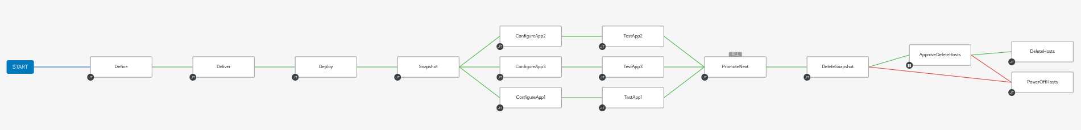
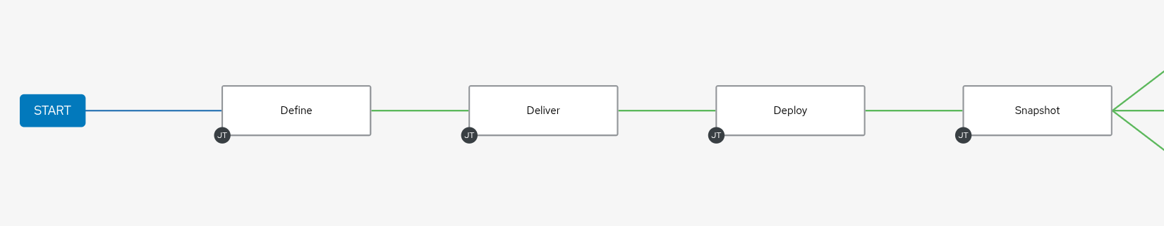
Automating SOE Delivery and Testing Pipeline
Red Hat Infrastructure Standard Adoption Model
Update Errata Filter end date and Publish
[Define]
Promote CVs and CCVs to Dev
[Deliver]
Build Test Systems from Host Groups
[Deploy]
Snapshots for Future Tests if Necessary
Notes:
[Content Owner]: Paul Armstrong

Slide 95
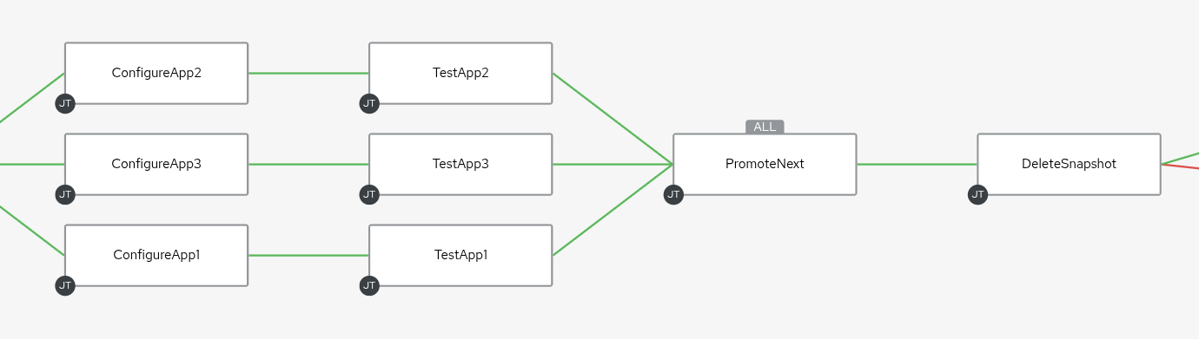
Automating SOE Delivery and Testing Pipeline
Red Hat Infrastructure Standard Adoption Model
Promote CVs and CCVs to QA if ALL tests succeed!
Delete Snapshots
[Destroy]
Not Shown:
On Failure Page OnCall Automation Admin
Install/Configure Application
[Configure]
Test Application
[Test]
Notes:
[Content Owner]: Paul Armstrong

Slide 96
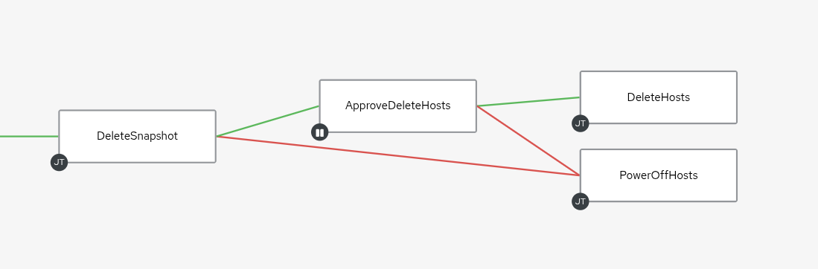
Automating SOE Delivery and Testing Pipeline
Red Hat Infrastructure Standard Adoption Model
Cleanup
Alternately, we can have an Approval Action on deleting or reverting the snaphot
Power Off for further analysis
[Review]
Delete Snapshots
[Destroy]
Approval Action
[Review]
Notes:
[Content Owner]: Paul Armstrong

Slide 97
Remember: Seeing it as a series of pipeline models
Red Hat Infrastructure Standard Adoption Model
New Content
Development
Rev
Mon
Def
Del
Dep
Con
Man
Main
Automated Delivery
Test
Dest
Binary Content (rpms, etc..)
Configuration Code
Configuration Templates
Application Code / Containers
New Content
Qualification
Rev
Mon
Feedback
Test Results
Error Reports
Dep
Con
Man
Main
Test
Dest
next…
Binary Content (rpms, etc..)
Configuration Code
Configuration Templates
Application Code / Containers
New Content
Notes:
[Content Owner]: Paul Armstrong
Including slide again as a reminder of the overall pipeline flow, which then transitions into the next slide, where the series of pipelines is showcased via chained AAP2 workflow templates with feedback loops/error corrections

Slide 98
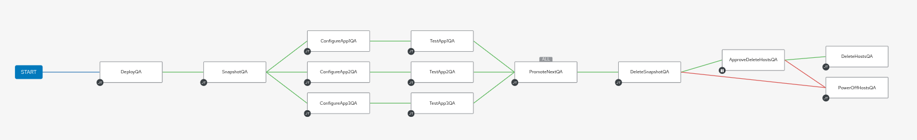
Automating SOE Delivery and Testing Pipeline Flow
Red Hat Infrastructure Standard Adoption Model
Automated Delivery
QUALIFICATION
Notes:
[Content Owner]: Paul Armstrong

Slide 99
Automating SOE Delivery and Testing Pipeline Flow
via chained Ansible Automation Platform workflow templates incorporating feedback loops
Red Hat Infrastructure Standard Adoption Model
Automated Delivery
DEVELOPMENT
QUALIFICATION
NEXT
Notes:
[Content Owner]: Paul Armstrong

Slide 100
Patching
Red Hat Infrastructure Standard Adoption Model
Notes:
[Content Owner]: Paul Armstrong

Slide 101
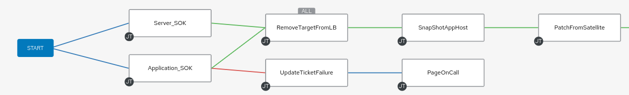
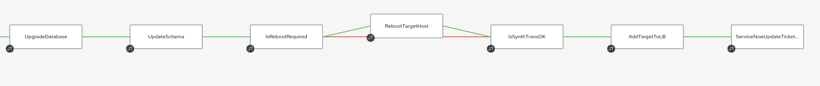
Automating SOE Patching Operations
Red Hat Infrastructure Standard Adoption Model
A Long workflow to patch a set of systems… let’s zoom in
Notes:
[Content Owner]: Paul Armstrong

Slide 102
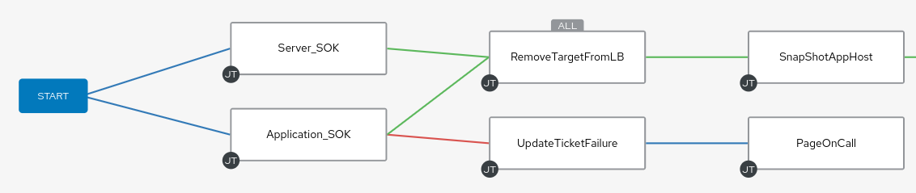
Automating SOE Patching Operations
Red Hat Infrastructure Standard Adoption Model
This section would be attached to each node “On Failure” but the links are removed for clarity.
Notes:
[Content Owner]: Paul Armstrong

Slide 103
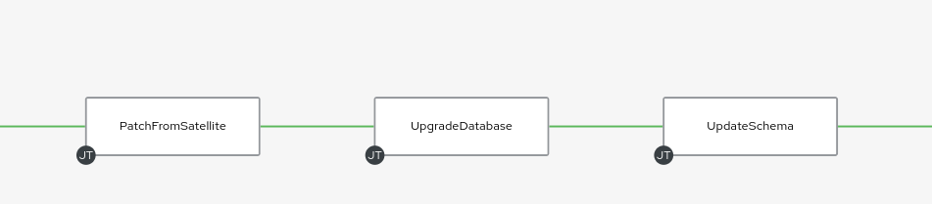
Automating SOE Patching Operations
Red Hat Infrastructure Standard Adoption Model
This section runs our patch process. Patch the server. Upgrade DB software. Update Schema.
Notes:
[Content Owner]: Paul Armstrong

Slide 104
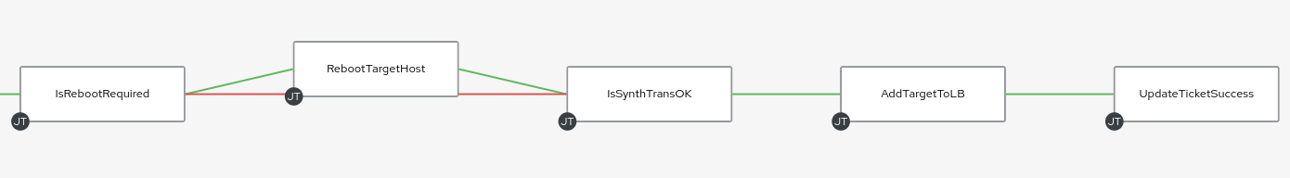
Automating SOE Patching Operations
Red Hat Infrastructure Standard Adoption Model
Reboot and Test. Add it back to the group… Rinse, Repeat with the next node.
Notes:
[Content Owner]: Paul Armstrong

Slide 105
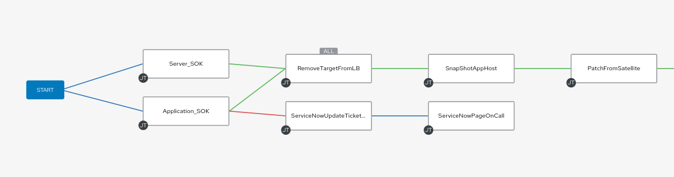
Automating SOE Patching Operations
Red Hat Infrastructure Standard Adoption Model
Notes:
[Content Owner]: Paul Armstrong

Slide 106
Red Hat Infrastructure Standard
and
Cloud Landing Zones
Red Hat Infrastructure Standard Adoption Model
Notes:
[Content Owner]: Paul Armstrong

Slide 107
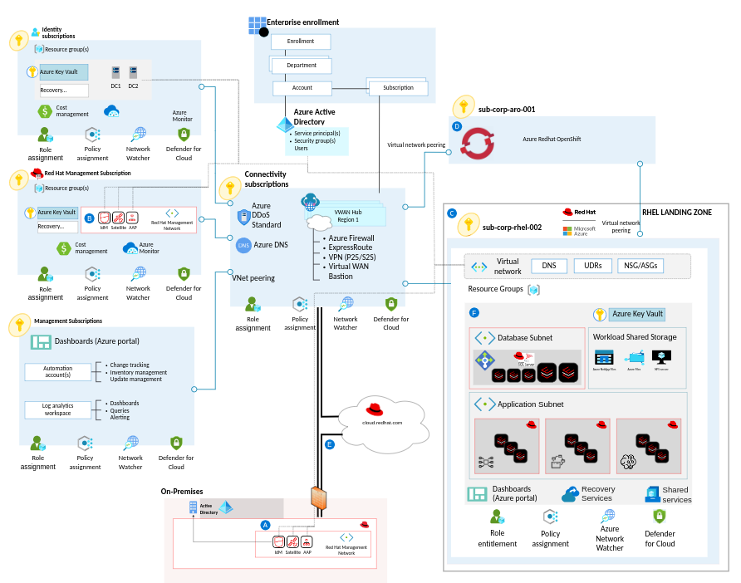
Azure Landing Zone for RHEL
Red Hat Infrastructure Standard Adoption Model
An opinionated architecture for Red Hat Enterprise Linux (RHEL) on Azure:
Validated with Microsoft and Microsoft Partners and customers
target technical state for a RHEL Solution following the Red Hat Infrastructure Standard Adoption Model using Infrastructure as Code
Describes critical considerations and recommendations for deploying RHEL Management and RHEL Workloads in Azure
Describes how you would deploy Red Hat Identity Management, Red Hat Satellite, and Red Hat Ansible Automation Platform to manage RHEL workloads
Provides automation tooling to deploy the management components and workload components
Notes:
[Content Owner]: Paul Armstrong

Slide 108
Red Hat Infrastructure Review
Red Hat Infrastructure Standard Adoption Model
Notes:
[Content Owner]: Paul Armstrong

Slide 109

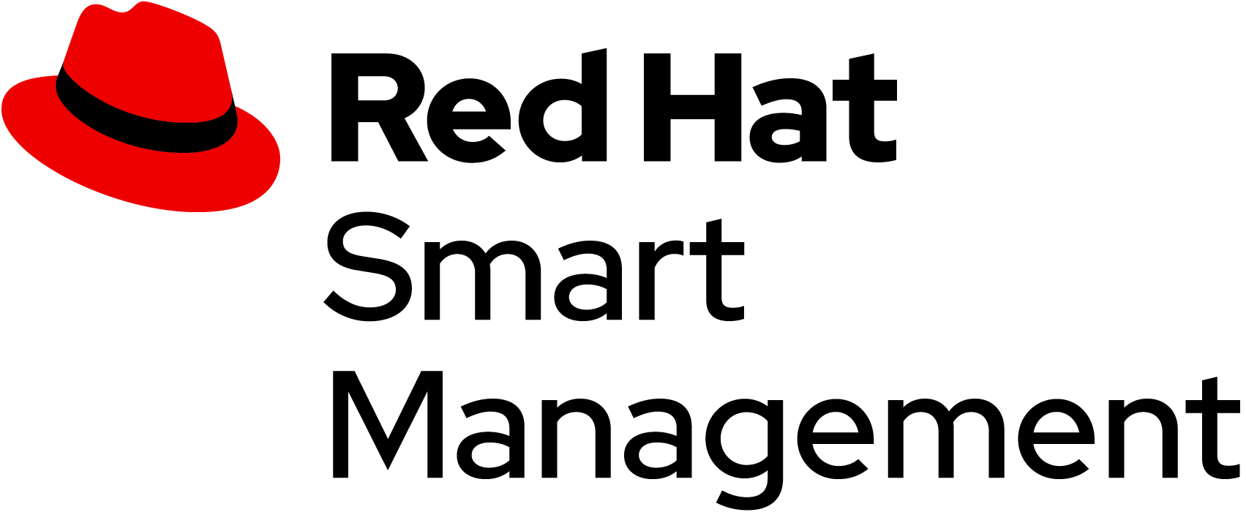
Red Hat Management Portfolio
Red Hat Infrastructure Standard Adoption Model
Identity
AUTOMATION FOR EVERYONE
Simple, Powerful, Agentless
Cross Platform
Systems, Network, Storage, Cloud
Human Readable
PREVENT CRITICAL ISSUES BEFORE THEY OCCUR
Continuous Insights
Verified Knowledge
Proactive Resolution
Included with Red Hat Enterprise Linux.
FLEXIBILITY TO MANAGE RED HAT ENTERPRISE LINUX
Secure software supply chain and content lifecycle on-premise or in the cloud with Satellite and Red Hat Hybrid Cloud Console
MANAGE LINUX IDENTITY AND POLICY
Single Sign On, sudoers, RBAC, HBAC, SELinux Policy, ID mapping, Native AD Integration.
Included with Red Hat Enterprise Linux.
Notes:
[Content Owner]: Paul Armstrong
Note: The product Icons may appear odd on your screen but display properly in presentation mode

Slide 110







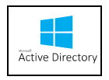





1,000+
1,000+
Applications
Infrastructure
Infrastructure
Services
Infrastructure
Tools
Lifecycle
Compliance
Core services
DNS
IPAM
Automation
TIME
etc..
Configuration
Security/SSO
Notes:
How do we help you win Edge deals? Our new DCS SKUs.
Our approach to the Edge market is “Run any workload, on any footprint, in any location.”
This approach is supported by the view (or fact) that Edge is essentially the decentralization & distribution of compute/storage/networking (which are the core functions of a data center) to remote locations to enable faster decisions and other benefits. With our strong position in the data center w/RHEL and Openshift, this makes sense.
Our traditional business is in the core data center, with low volumes and high performance.
Edge solutions are distributed computing outside the core data center.
The further you go from the data center, volumes are higher, performance requirements are lower, and pricing pressure increases.
For Edge we are now providing up to (depending on the product & fit) 3 new SKUs for each of our existing core products → these are the 3 DCS tiers (or use cases) shown in the graphic.
They are intended for use specifically in the 3 Use Cases, which are now defined in our Appendix 1 EULA.
As a result, they have strict guidelines for use that all Red Hat and partner sales organizations need to follow to remain compliant and/or ensure their customers remain compliant.
NOTE: the volumes noted are cumulative volumes over 3 years

Slide 111
Red Hat Infrastructure Standard Adoption Model
On Target Operations
These recommendations are provided to:
Help customers identify supported deployment models
Identify use cases that match the intended use of the software
Identify configurations that maximize the utility of the solutions
Identify workflows that to simplify and accelerate Linux operations
Demonstrate Red Hat technology integration points for service delivery
Help customers create processes that simplify, optimize and automate the management of Red Hat Enterprise Linux infrastructure to reduce cost and accelerate delivery of services.
Integrate traditional infrastructure into a comprehensive devops model
Notes:
[Content Owner]: Paul Armstrong

Slide 112
Services Offering
Red Hat Infrastructure Standard Adoption Model
Notes:
[Content Owner]: Paul Armstrong

Slide 113
Red Hat Infrastructure Standard Adoption Model
RH Services: Red Hat Infrastructure Standard
Red Hat Infrastructure Standard Adoption Model
A modular framework to support customer infrastructure modernisation - click on components for more information
Migrate to RHEL
Analysing workloads on non-RHEL platforms (inc. legacy UNIX, Windows, +Linux), creating a migration strategy, replatforming candidate workloads on RHEL using a migration factory approach.
Convert to RHEL
Analysing and converting in-place rpm based operating systems to RHEL.
This allows in-place upgrade to eliminate technical debt.
Upgrade to RHEL8 or 9
Analysis and in-place upgrading servers running older versions of RHEL to RHEL8 or RHEL9.
Modernize Virtualization
Deploy New Virtualization Platforms and migrate workloads onto it.
Modernize Application Delivery
Analysis and migration of applications running any operating system to a standard methodology
Deliver All Standard Workloads through Automation
Plugable Solutions
at least one + Contribute
Implement the Red Hat Infrastructure Standard*
Required :building a secure, stable, manageable, automated RHEL platform to scale workloads on
Foundational
Navigate to the Red Hat Infrastructure Standard
Engage with Red Hat to fully determine requirements, operational readiness.
* This component is mandatory unless the customer already has a RHEL Standard Operating Environment in place.
Notes:
[Content Owner: Martijn Ten Heuvel and Paul Armstrong]
List:
Migrate to RHEL document
Convert to RHEL document
Upgrade to RHEL9 document (DONE)
Migration pilot for OSP (openstack) - does that still have a value?
Add a new box: migrate to OCP virtualization, find the virtualization approach build.
Same with HANA
SOE Provisioning also is a link.

Slide 114
Red Hat Infrastructure Standard Adoption Model
Red Hat Infrastructure Standard aligned Services
Red Hat Infrastructure Standard Adoption Model
A modular framework to support customer infrastructure modernisation - click on components for more information
Migrate to RHEL
Analysing workloads on non-RHEL platforms (inc. legacy UNIX, Windows, +Linux), creating a migration strategy, replatforming candidate workloads on RHEL using a migration factory approach.
Convert to RHEL
Analysing and converting in-place rpm based operating systems to RHEL.
This allows in-place upgrade to eliminate technical debt.
Upgrade to RHEL8 or 9
Analysis and in-place upgrading servers running older versions of RHEL to RHEL8 or RHEL9.
Modernize Virtualization
Deploy New Virtualization Platforms and migrate workloads onto it.
Modernize Application Delivery
Analysis and migration of applications running any operating system to a standard methodology
Deliver All Standard Workloads through Automation
Plugable Solutions
at least one + Contribute
Implement the Red Hat Infrastructure Standard*
Required :building a secure, stable, manageable, automated RHEL platform to scale workloads on
Foundational
Navigate to the Red Hat Infrastructure Standard
Engage with Red Hat to fully determine requirements, operational readiness.
* This component is mandatory unless the customer already has a RHEL Standard Operating Environment in place.
Notes:
[Content Owner: Martijn Ten Heuvel and Paul Armstrong]
List:
Migrate to RHEL document
Convert to RHEL document
Upgrade to RHEL9 document (DONE)
Migration pilot for OSP (openstack) - does that still have a value?
Add a new box: migrate to OCP virtualization, find the virtualization approach build.
Same with HANA
SOE Provisioning also is a link.

Slide 115
Upgrades and migrations
Timeline
Multiple timelines, common endstate
RHEL based
Older RHEL
RH-ISAM based *
Other Linuxes
>>> time >>>
Where you are
Where you want to be
* The landing zone would always be the RH-ISAM based solution - this is where we want to be so this is what would then be prepared and provides the most current version of the RHEL SOE based on the customers standards.
Notes:
[Content Owner: Martijn Ten Heuvel, Jelke Dijkstra]
There are basically 3 sources we can come from.
This first is a RHEL based OS such as CentOS or Oracle Linux. These are converted. See portfoliohub for this solution.
The second are older RHEL versions, such as RHEL6, 7 or 8. These are in place upgraded. See portfoliohub for this solutions (IPU)
Finally, we have other linuxes - these can technically not be converted or upgraded and need to always be migrated to the RH ISAM solutio - or older Operating Environments like HPUX. Other examples are Debian based distributions or SLES.
To execute these conversions, upgrades and migrations the Red Hat Infrastructure Standard components are needed:
Red Hat Satellite
Red Hat Ansible Automation Platform
Red Hat Identity Manager.
All of these will need to be integrated into the existing customer environment.
This is a separate deck: details provided here for completeness.

Slide 116
Upgrades and migrations
Timeline
Convert to Red Hat Enterprise Linux
RHEL based
convert to RHEL7
Older RHEL
“We need python 2 for our application”
Other Linuxes
>>> time >>>
Where you are
Where you want to be
Notes:
[Content Owner: Martijn Ten Heuvel]
There are basically 3 sources we can come from. This is the first, a RHEL based OS such as CentOS
RHEL based linuxes. These could be migrated with convert2rhel. https://www.redhat.com/en/blog/converting-centos-rhel-convert2rhel-and-satellite
It would be advised to convert only 7 and higher, as 6 would already need Extended Lifecycle Support and should therefor be considered as the last category
The upgrade path is ALWAYS an option. Another options is to let the workload and it’s servers EOL. The decision tree would be applicable to each application.
The convert to RHEL 7 would be an initial step: the platform becomes supported - see Slide 3: Red Hat Enterprise Linux Life-cycle dates for how long

Slide 117
Upgrades and migrations
Timeline
Convert to Red Hat Enterprise Linux
RHEL based
convert to RHEL7
convert to RHEL8
“Moving to RHEL8 solves our support issue”
Older RHEL
Other Linuxes
>>> time >>>
Where you are
Where you want to be
Notes:
[Content Owner: Martijn Ten Heuvel]
There are basically 3 sources we can come from. This is the first, a RHEL based OS such as CentOS
We can convert 2 RHEL8 too, based on an 8 release.
The upgrade path is ALWAYS an option. Another option is to let the workload and it’s servers EOL. The decision tree would be applicable to each application.
The convert to RHEL7 would be an initial step: the platform becomes supported - see Slide 3: Red Hat Enterprise Linux Life-cycle dates for how long
Next steps would be to follow the inplace upgrades (see Slide 7: Upgrade and migrations)

Slide 118
Upgrade and migrations
Timeline
Convert to Red Hat Enterprise Linux
“We move from CentOS stream to RHEL”
RHEL based
convert to RHEL7
convert to RHEL8
convert to RHEL9
Older RHEL
Other Linuxes
>>> time >>>
Where you are
Where you want to be
Notes:
[Content Owner: Martijn Ten Heuvel]
There are basically 3 sources we can come from. This is the first, a RHEL based OS such as CentOS
Finally, we can convert from an 9 based distribution to RHEL9 too
The upgrade path is ALWAYS an option. Another option is to let the workload and it’s servers EOL. The decision tree would be applicable to each application.
The convert to RHEL7 would be an initial step: the platform becomes supported - see Slide 3: Red Hat Enterprise Linux Life-cycle dates for how long
Next steps would be to follow the inplace upgrades (see Slide 7: Upgrade and migrations)

Slide 119
Upgrade and migrations
Timeline
In place upgrades
RHEL based
“We need python 2 for our application”
Older RHEL
IPU* to RHEL7
Other Linuxes
>>> time >>>
Where you are
Where you want to be
* In place upgrades
Notes:
[Content Owner: Martijn Ten Heuvel]
There are basically 3 sources
Older RHEL versions can be IN PLACE UPGRADEd to newer RHEL versions (IPU).
This could start with RHEL 6 which can theoretically be upgraded to 7 using the tools described here: https://access.redhat.com/documentation/en-us/red_hat_enterprise_linux/7/html-single/upgrading_from_rhel_6_to_rhel_7/index
We do prefer to use LEAPP, which is available starting with RHEL7. Refer to the life-cycle dates - upgrading RHEL6 would need a support exception.
A RHEL7 box would currently be in support - meaning this could be there until the app goes EOL.
The upgrade path is ALWAYS an option. Another options is to let the workload and it’s servers EOL. The decision tree would be applicable to each application.

Slide 120
Upgrade and migrations
Timeline
Multiple timelines come together
RHEL based
convert toRHEL7
convert to RHEL7
IPU* to RHEL7
Older RHEL
IPU* to RHEL7
IPU* to RHEL8
IPU* to RHEL8
Other Linuxes
>>> time >>>
Where you are
Where you want to be
* In place upgrade
Notes:
[Content Owner: Martijn Ten Heuvel]
There are basically 3 sources
Older RHEL versions can be IN PLACE UPGRADEd to newer RHEL versions (IPU).
Once RHEL7 is there, we can IPU to RHEL8
This also applies to the converted systems! This means, we can convert those to RHEL8 too, using the same methodology.
The upgrade path is ALWAYS an option. Another options is to let the workload and it’s servers EOL. The decision tree would be applicable to each application.

Slide 121
Upgrade and migrations
Timeline
Multiple timelines come together
RHEL based
convert to RHEL7
convert to RHEL8
Older RHEL
IPU* to RHEL7
IPU* to RHEL8
IPU* to RHEL9
Other Linuxes
>>> time >>>
Where you are
Where you want to be
* In place upgrade
Notes:
[Content Owner: Martijn Ten Heuvel]
There are basically 3 sources
Older RHEL versions can be upgraded to newer RHEL versions.
Once RHEL7 is there, we can IPU to RHEL8
This also applies to the converted systems! This means, we can convert those to RHEL8 too, using the same methodology.
Once RHEL8 is deployed, we can IPU to RHEL9, which is the most recent version.
The upgrade path is ALWAYS an option. Another options is to let the workload and it’s servers EOL. The decision tree would be applicable to each application.

Slide 122
Upgrade and migrations
Timeline
Multiple timelines
RHEL based
convert to RHEL7
convert to RHEL8
convert to RHEL9
Older RHEL
IPU* to RHEL7
IPU* to RHEL8
IPU* to RHEL9
Other Linuxes
>>> time >>>
Where you are
Where you want to be
* In place upgrade
Notes:
[Content Owner: Martijn Ten Heuvel]
There are basically 3 sources
Now, we have 2 completed streams: Conversions and In Place Upgrades.
The outcome would be a supported platform, NOT a standardized platform.
To execute the conversions and the upgrades, the Red Hat Infrastructure Standard is needed.
The upgrade paths are ALWAYS an option. Another options is to let the workload and it’s servers EOL. The decision tree would be applicable to each application. (other deck)

Slide 123
Upgrade and migrations
Timeline
Migrate from Linux to Red Hat Enterprise Linux
RHEL based
Older RHEL
Other Linuxes
Workload migrations
RH-ISAM based *
>>> time >>>
Where you are
Where you want to be
* The landing zone would always be the RH-ISAM based solution - this is where we want to be so this is what would then be prepared and provides the most current version of the RHEL SOE based on the customers standards.
Notes:
[Content Owner: Martijn Ten Heuvel]
The migration from an alien Linux would always land on the RH-ISAM (or RH-IS) based platform, which is based on RHEL9.
This would be the RHEL9 which is most applicable to the customers environment, covering all integrations, dependencies, locations, etc.
As a migration would always be needed, this also takes the most effort, as the workloads need to be reviewed to understand them and to design the RH-ISAM-RHEL9 to accommodate for the workloads.

Slide 124
Upgrade and migrations
Timeline
Multiple timelines to similar results
RHEL based
convert to RHEL7
convert to RHEL8
convert to RHEL9
Workload
Migrations
RH-ISAM based
Older RHEL
IPU* to RHEL7
IPU* to RHEL8
IPU* to RHEL9
Other Linuxes
Workload migrations
>>> time >>>
Where you are
Where you want to be
* To move the converted
Notes:
[Content Owner: Martijn Ten Heuvel]
The workloads running on RHEL9, but not on the RH-ISAM based RHEL9 could be migrated to it. This should be a relative small step, but would require a redeployment of the application. This is an optional migration, but can be done.
As a migration would always be needed, this also takes the most effort, as the workloads need to be reviewed to understand them and to design the RH-ISAM-RHEL9 to accommodate for the workloads.

Slide 125
Upgrade and migrations
Timeline
Application modernisation on the horizon
RHEL based
convert to RHEL7
convert to RHEL8
convert to RHEL9
Workload
Migrations
RH-ISAM based
Application Modernisation
Older RHEL
IPU* to RHEL7
IPU* to RHEL8
IPU* to RHEL9
Other Linuxes
Workload migrations
>>> time >>>
Where you are
Where you want to be
* To move the converted
Notes:
[Content Owner: Martijn Ten Heuvel]
Once the workloads have a standardized platform, attention can be put into application modernisation: the entire platform is supported for many years to come and the applications next steps to EOL, OCP, SaaS or Rebuilding are available without the current pressure of end of life for the platform.

Slide 126
Red Hat Infrastructure Standard Adoption Model
Where you want to be
Pilot
Discovery
Create and build modernisation paths
Deploy automation tools
Design and deploy SOE
Test modernisation of workloads Use side by side comparisons, use dark launches, test deployments
Define the factory
Define day 2 operations and other standards
Why is this important?
Who will be responsible?
Who will be involved in execution?
What is the task we need to execute?
What are target applications?
Navigate
Scale
Review the current environment and integrations, dependencies
Review applications and review systems running these applications, identify and commit to the order of migrations
Analyse where these applications can go to: RHEL, containers, bin, and so on.
High level design for the new RHEL environment, including security model based on HBAC and RBAC and central directory services
Common understanding of the task at hand
Deploy the modernisation factory
Plan for modernisation
Modernize remaining systems
Implement responsibilities
Where you are
Notes:
[Content Owner: Martijn Ten Heuvel]
What is not going to RHEL, but to a container, drifts out of this scope, unless it’s going to OCP Virt.

Slide 127
Wrapping Up
Red Hat Infrastructure Standard Adoption Model

Slide 128
Red Hat Infrastructure Standard
Red Hat Infrastructure Standard Adoption Model
An Open Hybrid Cloud
Red Hat Identity Management
Red Hat Satellite
Ansible Automation Platform
Red Hat Hybrid Cloud Console
Red Hat Image Builder
Kubevirt
Hypervisor
Cloud
Bare Metal
Any Cloud or Hypervisor Image

Slide 129
Discussion
Red Hat Infrastructure Standard Adoption Model
Notes:
[Content Owner]: Paul Armstrong

Slide 130
Thank you
Red Hat is the world’s leading provider of enterprise open source software solutions. Award-winning support, training, and consulting services make
Red Hat a trusted adviser to the Fortune 500.
Notes:
[Content Owner]: Paul Armstrong

Slide 131
Supplementary Slides
Red Hat Infrastructure Standard Adoption Model
Notes:
[Content Owner]: Paul Armstrong

Slide 132
Deployment Recommendations for
Satellite
Red Hat Infrastructure Standard Adoption Model
Notes:
[Content Owner]: Paul Armstrong

Slide 133

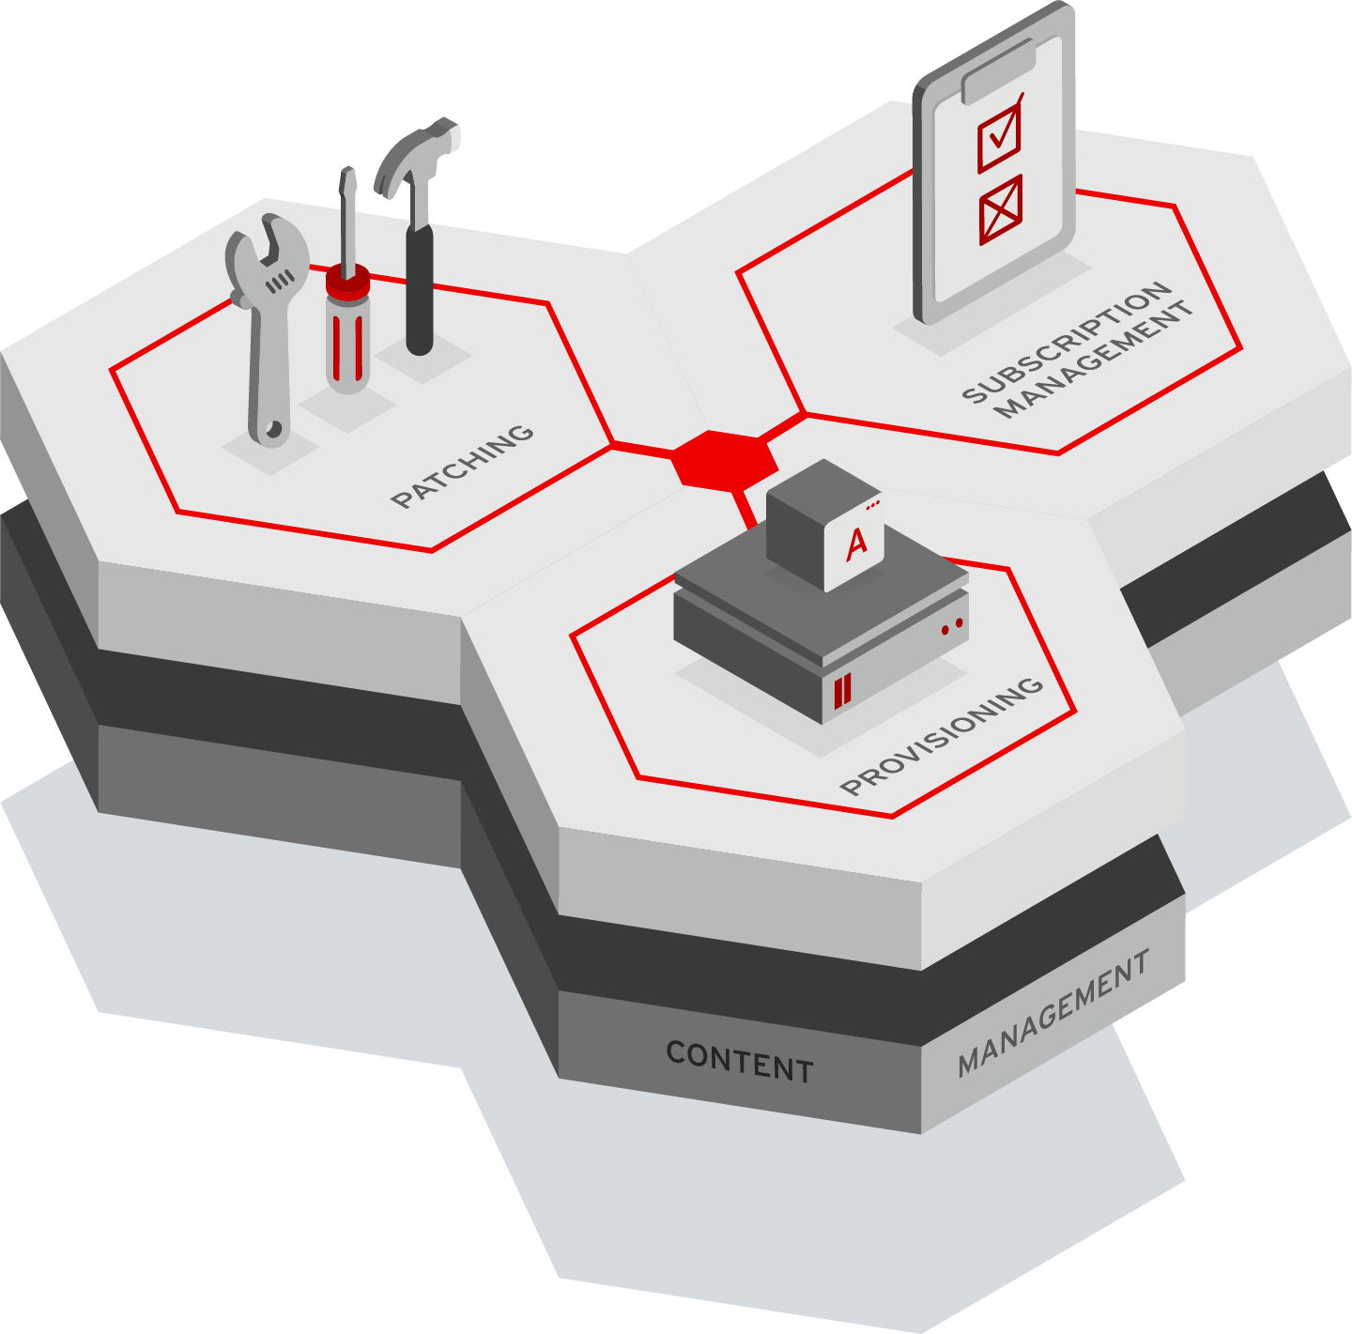
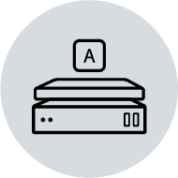



Satellite and Insights
Red Hat Infrastructure Standard Adoption Model
A Standard Operating Environment
An SOE provides the predictability and reliability required for the automation of system deployment, configuration, security and remediation.
This foundation ensures managed systems meet customer requirements while increasing efficiency and customer confidence.
The SOE starts with defining content, provisioning and patching.

Slide 134
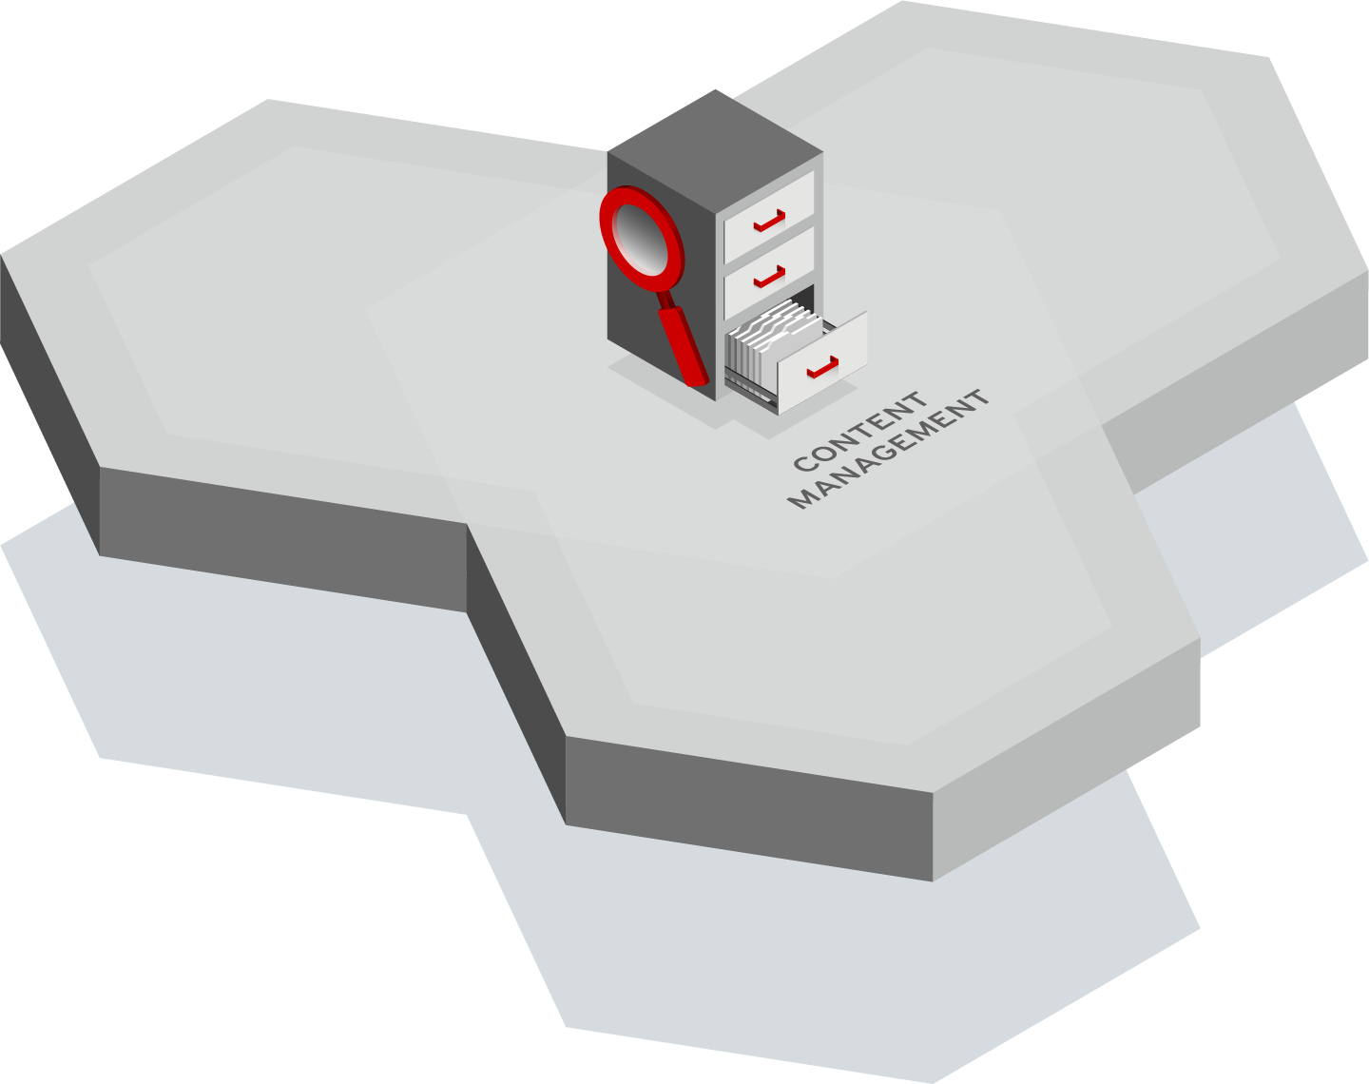
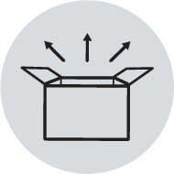


Content Management
Red Hat Infrastructure Standard Adoption Model
Content Repository any type of content made available to any host
Curation of content prior to distribution
Distribution of content as close as possible to the end point.
Notes:
Get and curate all the content.
Then you do creative things with it like provision and patch
ANY content type - Multiple content types - RPMs, ISOs, Binary, Container; Red Hat of third party
Powerful controls around the curation of content (CVs)
Federation of content - put as close to the end point as possible (using capsule servers)
Curation is being able to take an approved subset of the content and make it available.
If you have access to ALL RHEL content, you can make ONLY the security content available to hosts.
Federate content delivery as environments scale., IT has many workloads running (possibly around the world), which can lead to bandwidth issues. Satellite provides Capsule server that enable users to take all that content already organized and curated for their systems and put it as close to those systems as possible.
Why Federate? 1. Saves cost. Remote data centers may be charged by amount of data. 2. Saves time. If numerous systems are in a remote data center, it's much easier to get that content locally. 3. Helps meet SLAs -- new systems can be provisioned/patched locally.

Slide 135
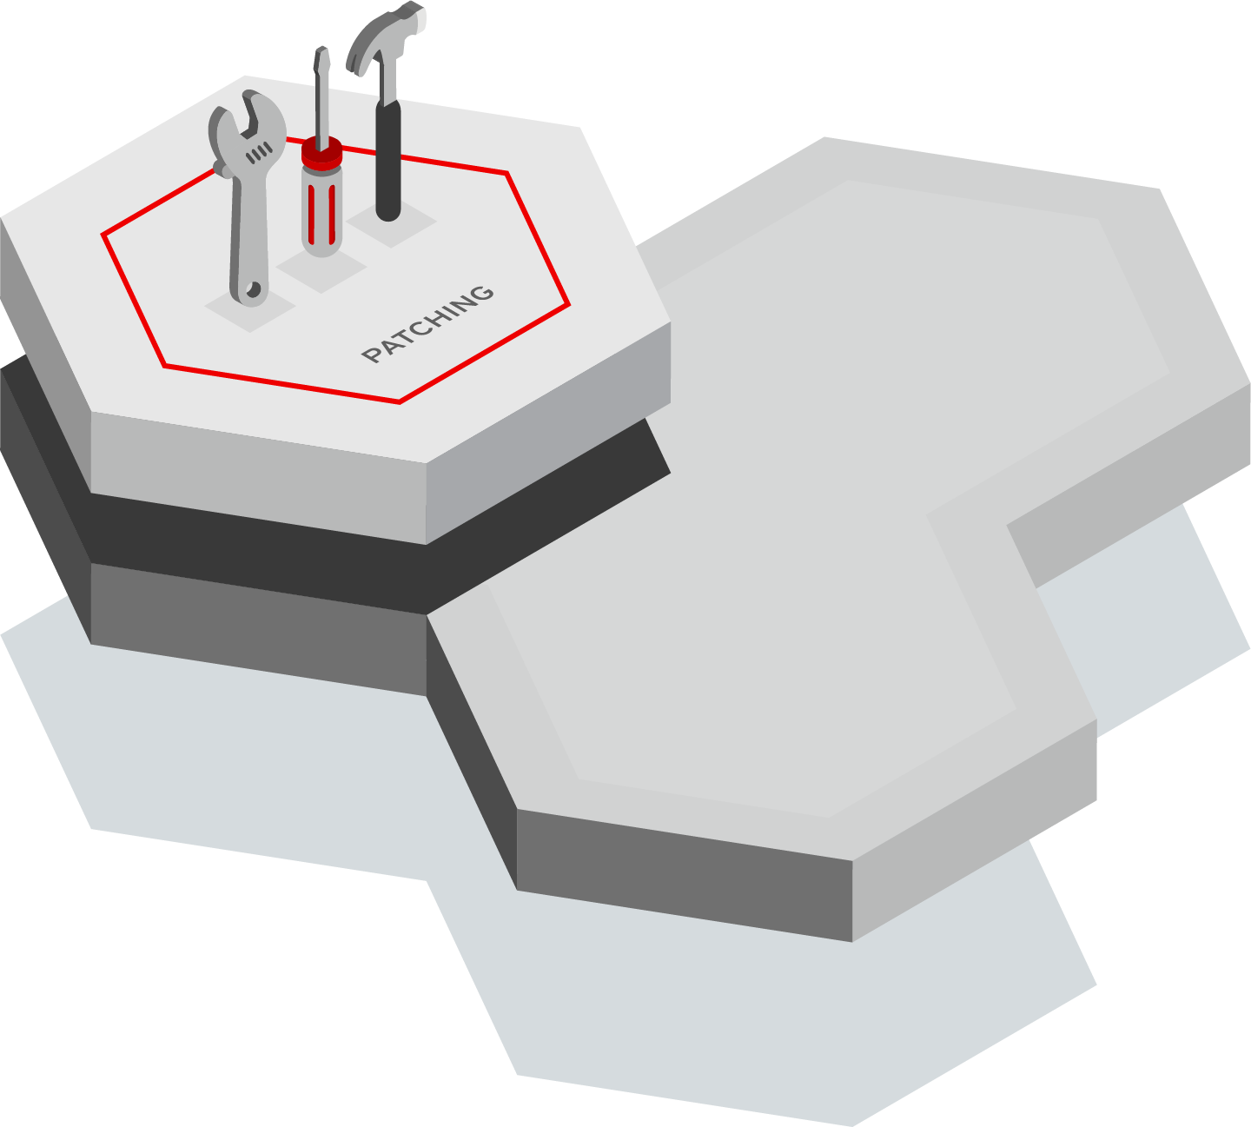


Patch Management
Red Hat Infrastructure Standard Adoption Model
Report on hosts that need updates, fixes, or enhancements
Group homogeneous systems so that you can easily work with them
Respond quickly to patching requirements using scalable automation
Notes:
ID and reporting phase - I need to know what systems in the environment are vulnerable.
I also need to know what systems have had patches already installed.
1st thing is reporting
Using Ansible and remote execution you can patch ALL of the systems in your environment quickly and easily. If you need to patch 50,000 systems at the click of a button you can do it with Satellite.
Group homogeneous systems so that you can easily work with them in subsets
----------
Define SOE
Satellite helps users define and maintain a Standard Operating Environment (SOE). Building an SOE includes 2 key things….
1. Defining your builds, workloads, apps, etc that run on Red Hat
2. Figuring out how to best manage and integrate those in your organization by looking at the enterprise -- from workloads to people who manage to patching methodologies, etc-- so that when it's time to build out new servers, etc, you have tools, processes in place to quickly create those.
Quickly respond to security vulnerabilities (Heartbleed/ ShellShock) Once an SOE is built, you have the means to quickly, efficiently and securely make changes. With Satellite and an SOE in place, changes are minimally invasive because all the hard work is done. Systems still need to be patched (and quickly), because the amount of time from a vulnerability being announced to that vulnerability being exploited is getting smaller and smaller.
Comply with your organization's security policies Once you define and categorize systems based on roles and profiles, it's much simpler to put methodologies in place to ensure security. Satellite provides complete control over what content is made available. For example, an organization's business-critical CRM system might get patched only for security. While web servers running other apps get kept as fresh as possible with enhancements, bug fixes, etc. Satellite (with the Environments and Content Views feature) can do both
Deploy all Red Hat Infrastructure as well as third-party software The ability to apply Red Hat and non-Red Hat software means that a user can put all those software bits in Satellite and it can be deployed. Once Satellite has that content, it "owns" it and Satellite keeps track of it, improving security and ensuring better tracking of what is deployed on each system.

Slide 136
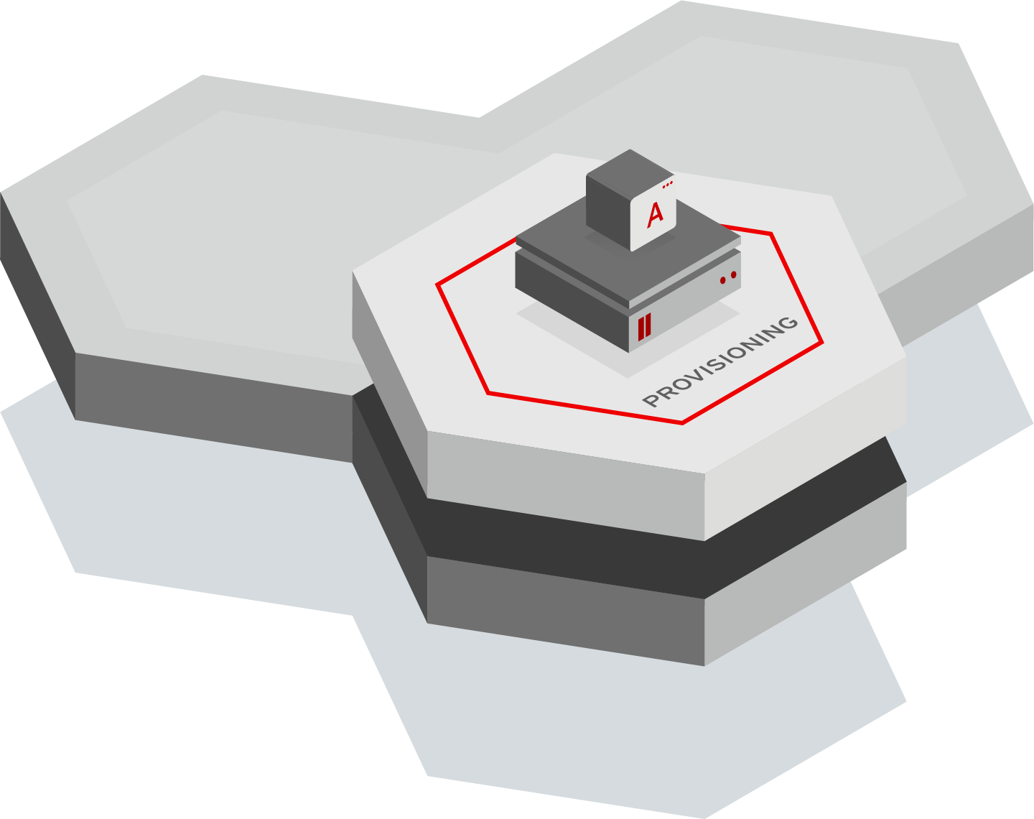

Provisioning Management
Red Hat Infrastructure Standard Adoption Model
Provision to bare metal, virtual, private, and public clouds
Automate using Ansible roles to perform post-provisioning steps
Import hosts provisioned outside of Satellite
Notes:
Provision to bare metal, virtual, private, and public clouds Most organizations have some mix of bare metal, virtual and cloud environments. Satellite allows users to connect to all of these and give the ability to create VMs, virtual instances in clouds, power on bare metal machines, etc . Satellite has the ability to integrate into existing infrastructure services like DNS, DHCP, and identity platforms, automating what normally would mean a multi-step process
Import non-provisioned hosts Discovery is a means to setup the networking infrastructure so that when new systems are brought in, you can simply turn them on and those servers will show up in Satellite as new systems to manage.
Automate

Slide 137
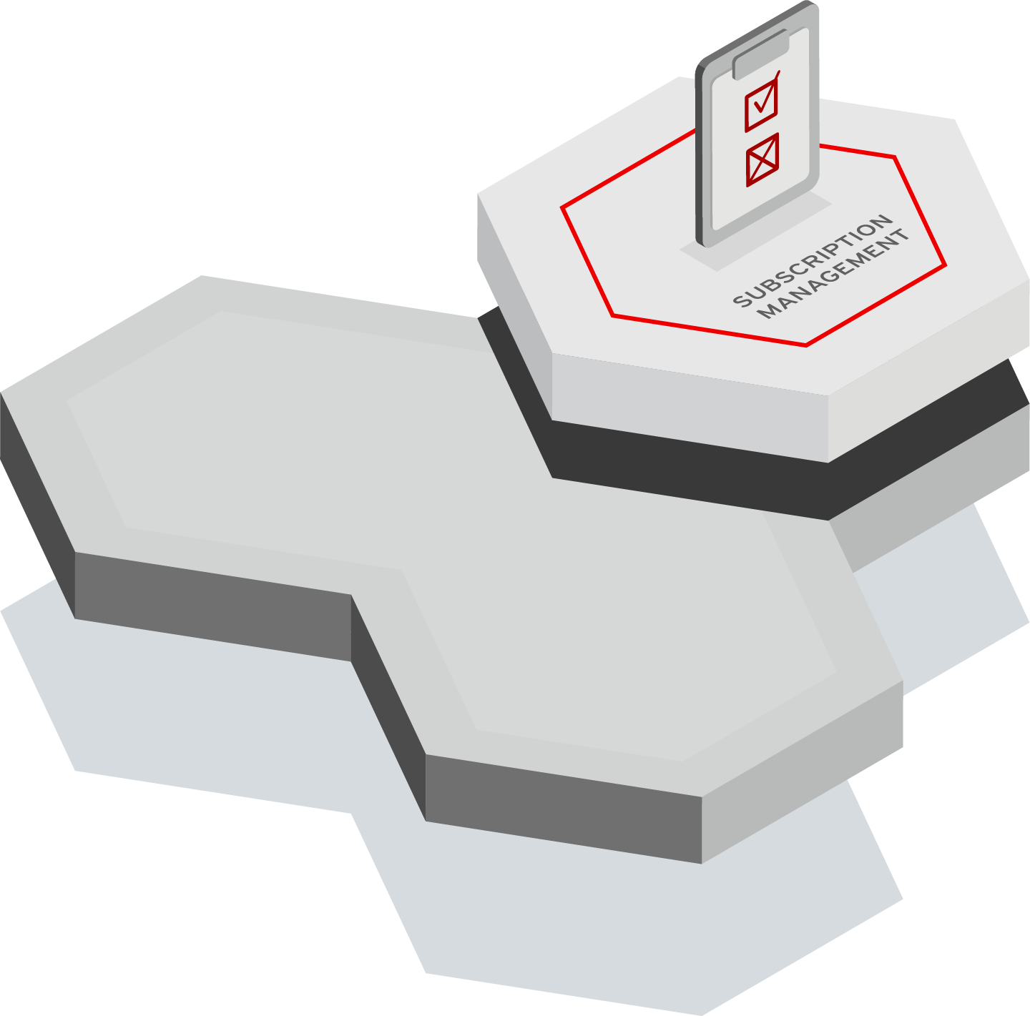
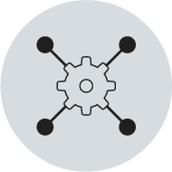

Subscription Management
Red Hat Infrastructure Standard Adoption Model
Centrally manage subscription usage
Maintain accurate inventory and utilization information
Report on subscription consumption
Notes:
Most enterprises know that they must keep track of all their software and hardware assets. Satellite collects a large number of facts about systems (server hardware inventory, date brought online, decommission date, etc), giving users one place to look for inventory and utilization information.
Satellite can also track hardware and other assets and report on consumption.
Report on subscription consumption on a group-by-group
Given the subscriptions that you have purchased from RH, this is the consumption of those subscriptions. You are using 92 of 100 RHEL.
In a multi-org Satellite I can report on a specific organization or on any arbitrary subset.
For ORG 1&2 show me all systems that have RHV in their subscriptions.
Show me all systems that are greater than 2 sockets and use a RHEL subscription.

Slide 138
Additional Satellite Capabilities
Red Hat Infrastructure Standard Adoption Model
Configuration Management using Ansible
Automation through integration with Ansible Tower
Compliance using OpenSCAP policies
Notes:
Additional capabilities that help to differentiate Satellite
---
System configuration in Satellite enables users to define desired state of systems. By leveraging declarative technology, we enable users to tell Satellite the desired end state, and Satellite figures out best way to get there. This means that administrators don't have to write scripts for each action. Satellite understands which tools to use based on the IT environment. It can also be used to manage and make changes and create new desired states.

Slide 139
Satellite and Insights Provide
Red Hat Infrastructure Standard Adoption Model
Standard Operating Environment hosts are the same across your environment
Reliable and Resilient infrastructure using Red Hat Insights
Secure your systems. Ensure they are patched, configured, and compliant with security policies
Scale your deployment across your hybrid multi-cloud environment with Confidence
Notes:
Outcomes slide
Maintain a Standard Operating Environment through standardizing and automating your Patching and Provisioning in Satellite
Reliable and resilient
Compliant
Confidence
Secure - Vulnerabilities, Patching, & OpenSCAP
Confidence that your deployment of workloads is in accordance with what you have purchased. Knowledge of if you are over or under deployed
NOTE TO SPEAKER: If you are working with an experienced Satellite customer then you can skip breakout slides below and only show this slide.
If presenting all slides:
In addition to the four primary use cases we discussed, Satellite also has many other capabilities that are critical to our customers.
These include but are not limited to features like
Security compliance through OpenSCAP
The ability to have multi users, each with their own roles and responsibilities with Satellite, enabling multi-tenancy
Built in auditing and reporting capabilities which vary depending on the specific item that you want to audit or report on
And predictive analytics enabled through Red Hat Insights.
If presenting this slide as a standalone suggested speaker notes:
Red Hat Satellite is a scalable platform to manage patching, provisioning, and subscription management of your Red Hat infrastructure.
On screen you see the Satellite coat of arms which in the center captures the four primary use cases for Satellite.
Patching and software management simplifies the process of managing hundreds or thousands of systems, enabling you to easily patch security vulnerabilities or deploy custom packages to your content hosts.
Subscriptions can be easily managed and tracked across your enterprise
Provisioning of servers can be simplified using profiles and new hosts can be quickly discovered, reducing the overall time it takes to provision new systems
And centralized configuration management can be used to detect and remediate drift and enable a standard operating environment.
Satellite has many additional capabilities such as integration with Red Hat Insights for predictive analytics and security compliance through OpenSCAP.
--------------
• Simplifies management of content, including security errata
•Makes it easy to manage and track subscriptions
• Enables provisioning on bare metal, virtualized and cloud-based infrastructures
• Provides life-cycle management for Red Hat infrastructure
------
On screen you see the Satellite coat of arms which in the center captures the four primary use cases for Satellite.
Patching and software management simplifies the process of managing hundreds or thousands of systems, enabling you to easily patch security vulnerabilities or deploy custom packages to your content hosts.
Subscriptions can be easily managed and tracked across your enterprise
Provisioning of servers can be simplified using profiles and new hosts can be quickly discovered, reducing the overall time it takes to provision new systems
And centralized configuration management can be used to detect and remediate drift and enable a standard operating environment.

Slide 140


Fleet-wide Visibility, Data Aggregation, Control, and Reporting
Red Hat Infrastructure Standard Adoption Model
Red Hat Insights @
CLOUD.REDHAT.COM
CONTENT,
DATA,
REMEDIATION,
REPORTING
DATA CENTER OR ORGANIZATION
DATA CENTER OR ORGANIZATION
DATA CENTER OR ORGANIZATION
DATA CENTER OR ORGANIZATION
For Red Hat Enterprise Linux OS
Inventory, Subscription Utilization
Configuration Recommendations
Drift Analysis
Vulnerability Analysis
Compliance
Remediation Playbook Generation
Resource Optimization
For Red Hat Satellite Integration
Aggregate across multiple Satellites
Red Hat Cloud Connector for Integration
Remote Ansible Remediation
Manifest Management
Edge Systems Managment
Notes:
-----
Start with the simplest scenario which is 1 Satellite and 1 Capsule connected to the internet
----
You have a group of hosts that you want to manage with Satellite.
These hosts are in the Atlanta datacenter
The hosts are connected to the Capsule. The Capsule is located closest to the hosts
The Capsule is connected to the Satellite
The Satellite is connected to the internet. From the internet we download content from Red Hat, Github, or any third party content provider
Through the Internet we also connect to cloud.redhat.com and Red Hat Insights

Slide 141

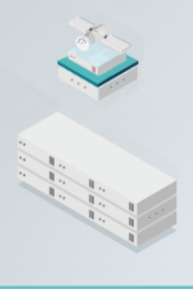
An Individual Data Center or Organization
Red Hat Infrastructure Standard Adoption Model
CLOUD.REDHAT.COM
RED HAT
CONTENT
GIT
CONTENT
SATELLITE INSIDE FIREWALLS
CONTAINER
CONTENT
Basic Deployment:
Single Satellite with Integrated Capsule
CUSTOM
CONTENT
…
PRIMARY
DATA CENTER
OTHER
SOURCES
Notes:
[Content Owner]: Mike Savage

Slide 142
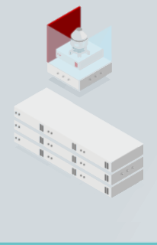
Extending to another Data Center
Red Hat Infrastructure Standard Adoption Model
CLOUD.REDHAT.COM
RED HAT
CONTENT
GIT
CONTENT
PRIMARY
SATELLITE
CONTAINER
CONTENT
CAPSULE
SECURE NETWORK
Multi-Site Deployment:
Single Satellite with Remote Capsule
CUSTOM
CONTENT
…
PRIMARY
DATA CENTER
OTHER
SOURCES
SECONDARY
DATA CENTER
Notes:
[Content Owner]: Mike Savage

Slide 143
Extending to a Cloud Data Center
Red Hat Infrastructure Standard Adoption Model
CLOUD.REDHAT.COM
CAPSULE
RED HAT
CONTENT
SECURE NETWORKS
GIT
CONTENT
CAPSULE
PRIMARY
SATELLITE
AWS EAST
CONTAINER
CONTENT
CAPSULE
Multi-Site Deployment:
Single Satellite with Remote Capsule and Capsules in Cloud Providers
CUSTOM
CONTENT
…
PRIMARY
DATA CENTER
AZURE CANADA CENTRAL
OTHER
SOURCES
SECONDARY
DATA CENTER
Notes:
[Content Owner]: Mike Savage

Slide 144
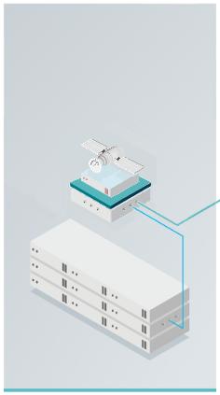
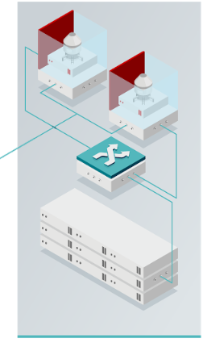

Securing Content Delivery
Red Hat Infrastructure Standard Adoption Model
CLOUD.REDHAT.COM
RED HAT
CONTENT
GITHUB
CONTENT
CONTENT
AGGREGATION
CONTENT
VERIFICATION
CONTENT
DISTRIBUTION
CONTAINER
CONTENT
DMZ NETWORK
SOFTWARE TESTING AND VERIFICATION NETWORK
(OPTIONAL)
Advanced Deployment:
Multiple Satellite Deployment with Content Verification Network
MICROSOFT
CONTENT
…
ON-PREMISE
DATA CENTER
CLOUD
PROVIDER
OTHER
SOURCES
DISTRIBUTION NETWORK
Notes:
[Content Owner]: Paul Armstrong
Satellite in the DMZ is able to connect to many sources - Red Hat, Github, Container Repositories, Microsoft, upstream repos and many others. These ports and connections can be more easy managed from the DMZ side of the network. Content verification capabilities are applied to ensure that the content is identified - certificates, GPG keys, etc..
OPTIONALLY - A Satellite sitting in a Verification Network can make a secure connection to the DMZ Satellite to synchronize content into the organization through a small number of defined ports to a single system. The purpose of this system is to allow for the security review of synchronized content to ensure that newly synchronized sources meet the organization’s security and compliance standards before being allowed to be synchronized into the production network and used.
Verified Content can be synchronized by a Satellite inside the corporate network. Minimal ports to a single secured system are opened to allow content to be brought into the network.
Port 443 between the Source Satellite and the Synchronizing Satellite for rpm, file, deb, etc.. content.
VERIFY
Port 5000 between the Source Satellite and the Synchronizing Satellite for container content
Can we synchronize container content
What port does container content get synchronized over.

Slide 145
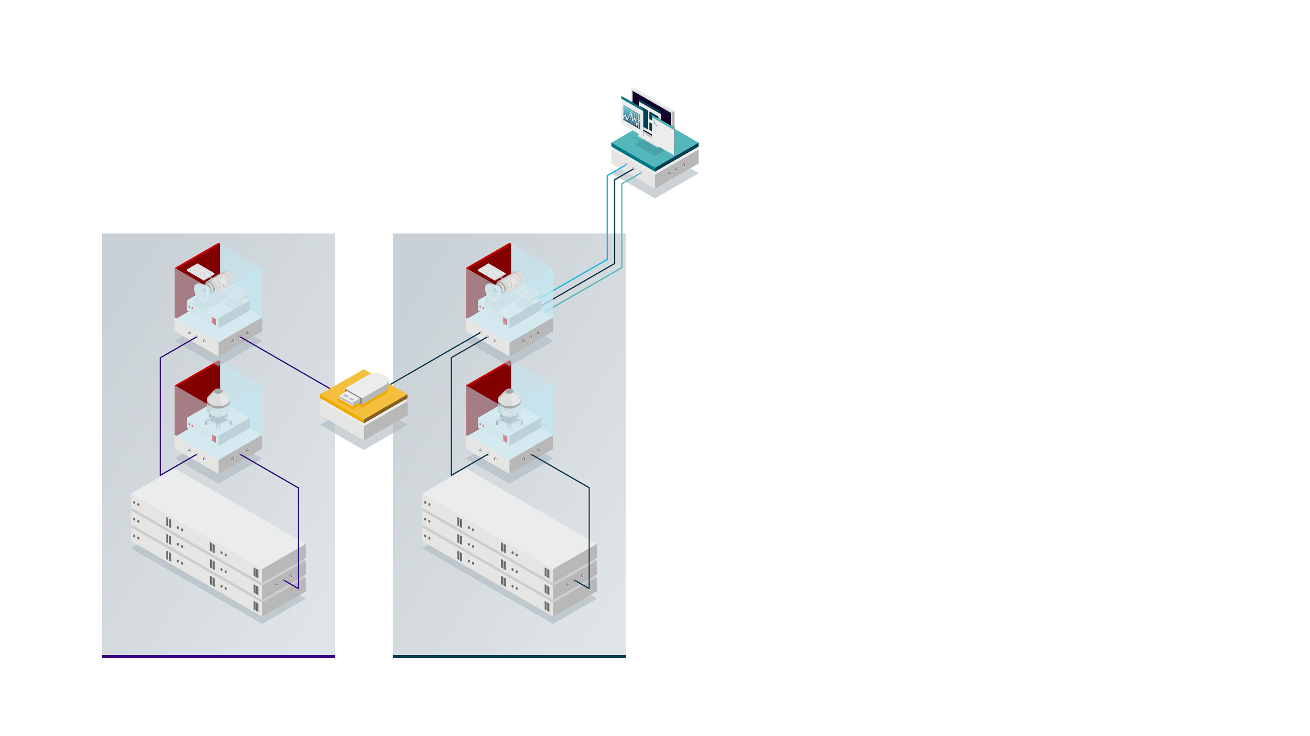

Providing Content to Air-Gapped Environments
Red Hat Infrastructure Standard Adoption Model
CLOUD.REDHAT.COM
CONTENT
IMPORT
EXPORT
ISOLATED DATACENTER
CONNECTED DATACENTER
Notes:
You also have an isolated datacenter configured in much the same way, but no access to the Internet. This environment is disconnected, airgapped, or isolated - whichever term you like to use.
Your main Satellite in the Atlanta datacenter downloads the content and the Satellite admin organizes the content into content view as needed.
The Satellite admin then exports that content to a thumb drive, optical disc, or whichever media is preferred.
The data is then imported into the Satellite in the isolated datacenter.
It should be noted that this process imports the content as well as the metadata that make up the content view.
If you are exporting a content view version, then the content view needs to already exist on the host where you are importing the content view.
And any underlying repositories do need to already exist before you import a content view version.
This will greatly simplify the import and export of content view, helping to keep Satellites and Capsules that are in disconnected environments as close to the main Satellite as possible

Slide 146
Deployment Recommendations for
Ansible Automation Platform
Red Hat Infrastructure Standard Adoption Model
Notes:
[Content Owner]: Paul Armstrong

Slide 147
Red Hat Infrastructure Standard Adoption Model (RHISAM) 2023
Notes:
[Content Owner]: Paul Armstrong

Slide 148
Deployment Recommendations for
Identity Management
Red Hat Infrastructure Standard Adoption Model (RHISAM) 2023
Notes:
[Content Owner]: Paul Armstrong

Slide 149
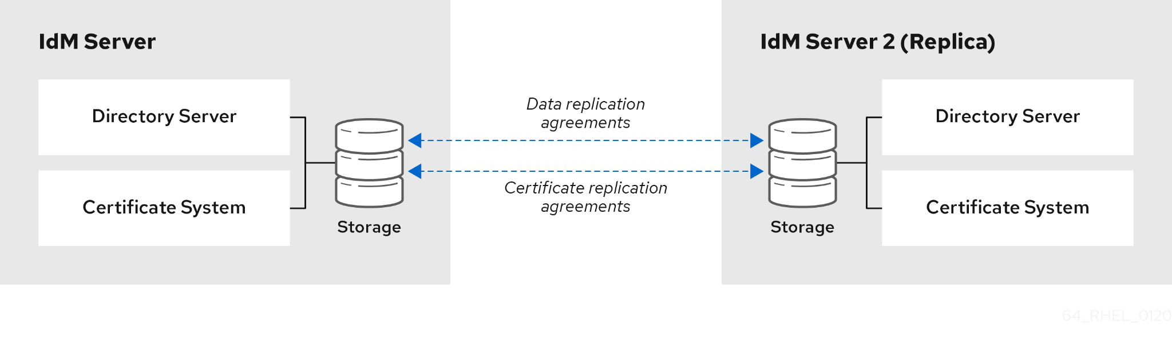
Identity Management Architecture
Red Hat Infrastructure Standard Adoption Model

Slide 150
The Golden Rules of IdM Replication
Red Hat Infrastructure Standard Adoption Model
Set up at least two replicas in each data center
Connect the replicas in a data center with each other
This ensures domain replication within the data center.
Connect each data center to at least two other data centers
This ensures domain replication between data centers.
Connect data centers using at least a pair of replication agreements
If data centers A and B have a replication agreement from A1 to B1, having a replication agreement from A2 to B2 ensures that if one of the servers is down, the replication can continue between the two data centers.
More than 4 replication agreements per server is not beneficial*
Receiver can only update one link at a time
* There are some good reasons for more than 4 agreements under certain circumstances.

Slide 151
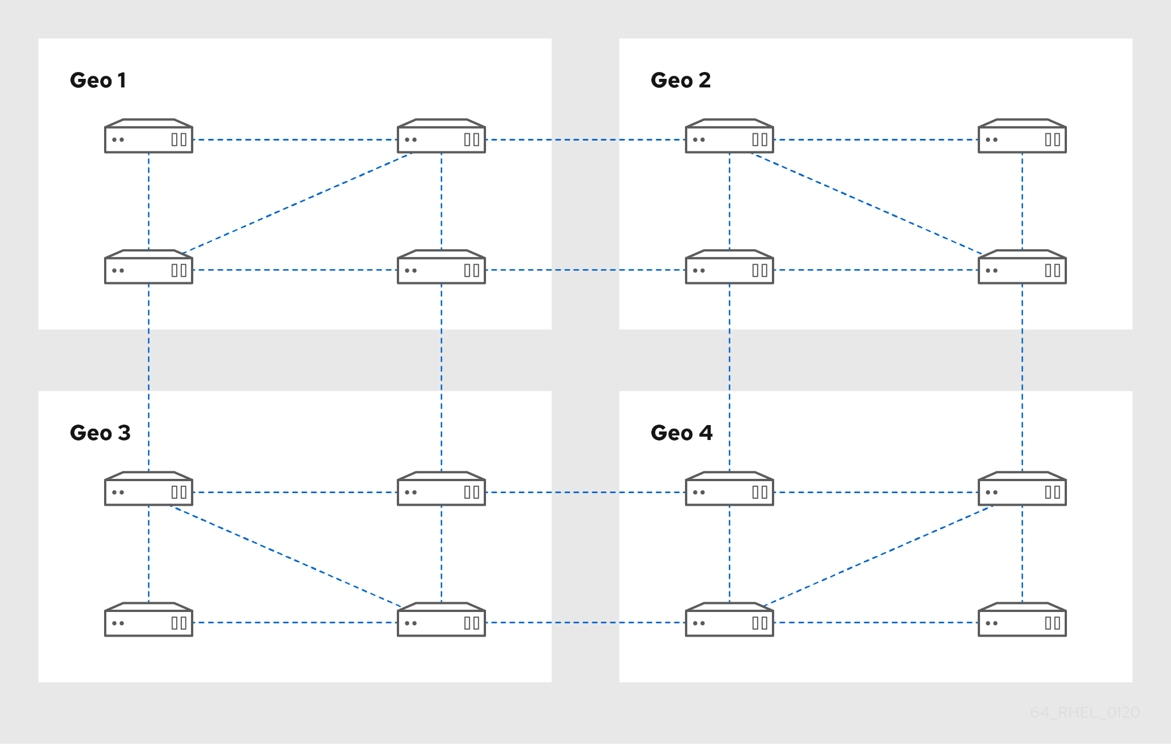
Reference Configurations for Identity Management
Red Hat Infrastructure Standard Adoption Model
Datacenter 1
Datacenter 2
Cloud 1
Cloud 2

Slide 152
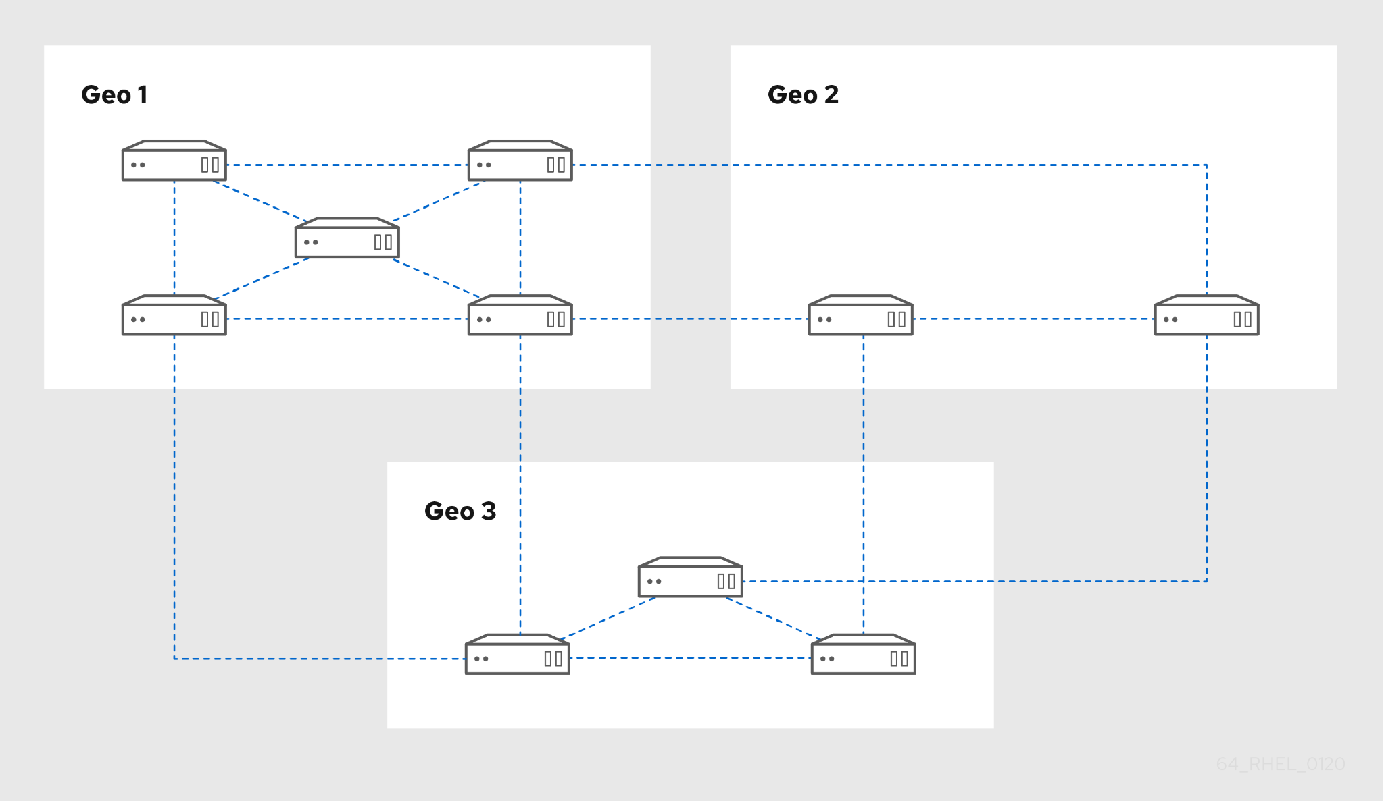
Reference Configurations for Identity Management
Red Hat Infrastructure Standard Adoption Model
Primary Datacenter
Regional Datacenter
Cloud 1

Slide 153

Active Directory Trust with Identity Management
Red Hat Infrastructure Standard Adoption Model
Bridges the user identity gap between Red Hat Enterprise Linux and Windows
Utilize native MS Trust Model integration with Active Directory to use AD as a single source of truth for user identities
Apply tailored access control policies directly to the Red Hat Enterprise Linux domain
Improve administrative efficiency by centralizing where policies are created
AD users can:
Log in to access Linux systems and resources.
Use single sign-on (SSO).
All IdM objects are managed in IdM in the trust.
All AD objects are managed in AD in the trust.

Slide 154
Security Policy with Identity Management
Red Hat Infrastructure Standard Adoption Model
Sudo Policy
Host Based Access Control
SELinux Group Policy
Define
WHO
gets to execute
WHAT COMMANDS
on
WHAT SYSTEMS
using
WHICH PERMISSIONS
Define
WHO
gets to login
WHERE
using
WHAT SERVICE
Define
WHO
is mapped to
WHICH SELinux USER
on
WHAT SYSTEMS
Users authenticate with AD
Linux Admins associate AD Groups
Linux Admins
manage Linux Policy
Appropriate Linux policy enforced on AD authenticated users without modification to AD schema or standard practice. Supports integration with Azure AD through OIDC support

Slide 155
Appendix 1
Red Hat Infrastructure Standard Adoption Model (RHISAM) 2023
Management Portfolio Tools Descriptions

Slide 156




Red Hat Infrastructure Standard Adoption Model
Introduction to identity management
Authentication
Single sign-on
Multi-factor authentication
Session and token management
Public Key Infrastructure (PKI)
Authorization
Roles
Rules
Attributes
Privileged access
Governance and compliance framework
Identity lifecycle management
Provisioning/deprovisioning
Delegation
Self-service
Certificate management
Reporting and analytics
Directory services
Identity store
Directory federation
Metadata synchronization
Virtual directory

Slide 157






Red Hat Infrastructure Standard Adoption Model
Identity Management in Red Hat Enterprise Linux
Centralize identity management, enforce security controls, and comply with security standards
Centralize
Manage identities and enforce authentication policies from a centralized location to ensure consistency across all platforms and footprints, improve the user experience, and ease IT burden.
Secure
Configure access requirements and customize permissions to enforce security controls based on the principle of least-privilege, ensuring the right people have the right access at the right time.
Comply
Implement compliance best practices and standards with an independently certified solution that supports your overall identity management strategy.
Live demo

Slide 158




Red Hat Infrastructure Standard Adoption Model
Identity Management in RHEL vs. third-party solutions
Comprehensively meet your compliance needs
Cater to a broad spectrum of use cases rather than using third-party point solutions that address a specific use case inside the enterprise.
Standardize across footprints and architectures
Provide a consistent user experience across physical, virtual, cloud, and edge footprints as well as other Red Hat solutions, such as Red Hat OpenShift®.
Zero added cost
Get Identity Management in Red Hat Enterprise Linux as part of your subscription, at no additional cost.
Third-party identity management solutions can be expensive and require additional investments that add to operational costs.
Enjoy consistent stability and support
Reduce the vendor and lifecycle management burden as it follows the RHEL product lifecycle and is supported by RHEL global experts.
Streamlined deployment and management at scale
Reduce the learning curve and accelerate adoption by using the tools you already know for automating identity management.

Slide 159
Red Hat Infrastructure Standard Adoption Model
Identity Management in Red Hat Enterprise Linux
Main Presentation

Slide 160
Extra Slides
Red Hat Infrastructure Standard Adoption Model (RHISAM) 2023

Slide 161

How do environments evolve?
Red Hat Infrastructure Standard Adoption Model
A server running Linux
Yay.
No network.
Local management of identity / authentication.
Local management of installed tools / apps
Local management of well… everything.
No problem!
Value == only discovery / learning
Notes:
[Content Owner]: Paul Armstrong

Slide 162

How do environments evolve?
Red Hat Infrastructure Standard Adoption Model
2 Servers running Linux
Yay. … Uh-oh
Network, name resolution, time services, centralized ID/An/Az, patching, build, policy definition, etc..
OK. These are good goals…
Notes:
[Content Owner]: Paul Armstrong

Slide 163
How do environments evolve?
Red Hat Infrastructure Standard Adoption Model
10 Servers running Linux
Oh, no…
These are becoming a necessity! We better get standards…
Notes:
[Content Owner]: Paul Armstrong

Slide 164
How do environments evolve?
Red Hat Infrastructure Standard Adoption Model
100 Servers running Linux
We have standards, right!?
Notes:
[Content Owner]: Paul Armstrong

Slide 165

How do environments evolve?
Red Hat Infrastructure Standard Adoption Model
But we had four groups
doing the same thing.
Which Standards?
How do we automate?
Notes:
[Content Owner]: Paul Armstrong

Slide 166
Day N - Infrastructure Upgrade Planning
Red Hat Infrastructure Standard Adoption Model (RHISAM) 2023
Notes:
[Content Owner]: Paul Armstrong

Slide 167
Secure Software Supply Chain
Red Hat Infrastructure Standard Adoption Model (RHISAM) 2023
Notes:
[Content Owner]: Paul Armstrong

Slide 168
Securing Content Delivery
Securing the Content Supply Chain
CLOUD.REDHAT.COM
RED HAT
CONTENT
GITHUB
CONTENT
CONTENT
AGGREGATION
CONTENT
VERIFICATION
CONTENT
DISTRIBUTION
CONTAINER
CONTENT
DMZ NETWORK
SOFTWARE TESTING AND VERIFICATION NETWORK
(OPTIONAL)
MICROSOFT
CONTENT
…
ON-PREMISE
DATA CENTER
CLOUD
PROVIDER
OTHER
SOURCES
DISTRIBUTION NETWORK
Notes:
[Content Owner]: Paul Armstrong
Satellite in the DMZ is able to connect to many sources - Red Hat, Github, Container Repositories, Microsoft, upstream repos and many others. These ports and connections can be more easy managed from the DMZ side of the network. Content verification capabilities are applied to ensure that the content is identified - certificates, GPG keys, etc..
OPTIONALLY - A Satellite sitting in a Verification Network can make a secure connection to the DMZ Satellite to synchronize content into the organization through a small number of defined ports to a single system. The purpose of this system is to allow for the security review of synchronized content to ensure that newly synchronized sources meet the organization’s security and compliance standards before being allowed to be synchronized into the production network and used.
Verified Content can be synchronized by a Satellite inside the corporate network. Minimal ports to a single secured system are opened to allow content to be brought into the network.
Port 443 between the Source Satellite and the Synchronizing Satellite for rpm, file, deb, etc.. content.
VERIFY
Port 5000 between the Source Satellite and the Synchronizing Satellite for container content
Can we synchronize container content
What port does container content get synchronized over.

Slide 169

There has to be an easier way
A Standard Operating Environment Example
Notes:
[Content Owner]: Paul Armstrong

Slide 170



Slide 171
Red Hat Infrastructure Standard Adoption Model
From Concept…
To Model…
To Pipeline…

Slide 172















DISCOVER > PLAN > AUTOMATE > MIGRATE
Refactor to RHEL Approach
THE APPROACH
DISCOVER
Identify and discover application running on source environment
VALIDATE
Test and validate application on target platform
Automation
UNIX/WINDOWS/LINUX
MIGRATE
Migrate identified application to target platform
Private
Bare Metal & Virtual
Public Clouds
Private
Bare metal & Virtual

Slide 174
Appendix

Slide 175
Contributing:
Editing - Please add your edits/comments to the main deck located here:
https://docs.google.com/presentation/d/1HGPE-Wod7XO9WRCCnnga3Qy3mcoifyusVlRaRAu_Pak
This is a shortened version of the main deck for customer overview presentations. It will be periodically updated.
Notes:
[Content Owner]: Paul Armstrong, Mike Savage

Slide 176
Contributing:
Editing - please add slides that you would like to see to the deck. If they need a section, add the section separator slide. Tag your slide in the content notes section with:
[Content Owner]: <Your Name>
This helps in collaborating with others. There are lots of editors :-)
You are responsible for maintaining your content in this deck. Please only edit your own content.
If you need to make changes for a customer presentation, please make a copy to your own drive.
Notes:
[Content Owner]: Paul Armstrong

Slide 177
Contributors & Reviewers
These folks had a hand in Contributors and/or reviewing this content.
Contributors
Paul Armstrong <parmstro@redhat.com> - Principal Technical Specialist - RoOT Canada - Oct 2023
Kristin Hendricks <krhendri@redhat.com> - Senior Program Manager - Global Services - Oct 2023
Mike Savage <msavage@redhat.com> - Chief Architect - CTO Org: Customer-led Open Innovation - Nov 2023
Jerone Young <jyoung@redhat.com> - Senior Architect - Consulting Services - Nov 2023
Reviewers
Notes:
[Content Owner]: Paul Armstrong

